Slide 1




MURAT BADEM
Managing Director
THE CURRENT STATE OF MOLDOVAN WALNUT PRODUCTION
DOES MOLDOVA HOLD POTENTIAL
Nisão NutVision
TO BE A STRONGER PLAYER?
Chișinău, February 27, 2025

Slide 2








Slide 3
Born in 1971, Istanbul, TURKEY
Residence : Lisbon, PORTUGAL
Masters in Business Administration – Financial Management, Pace University, New York, NY
20 years experience in the walnut industry, as a grower, processor, with international brands
Owned and operated the largest Commercial Walnut Nursery in Europe,
Areas of expertise :
Strategic Business Plans for Agricultural Projects,
Orchard Design and Establisment,
Harvest and Processing Technologies,
Improving Quality and Operational Efficiency in Walnut Production
International Marketing and establishing brands
MURAT BADEM
Managing Director
Nisão
NutVision
THE CURRENT STATE OF MOLDOVAN WALNUT PRODUCTION
DOES MOLDOVA HOLD POTENTIAL
TO BE A STRONGER PLAYER?
MURAT BADEM
Nisão NutVision
Chișinău, February 27, 2025

Slide 4


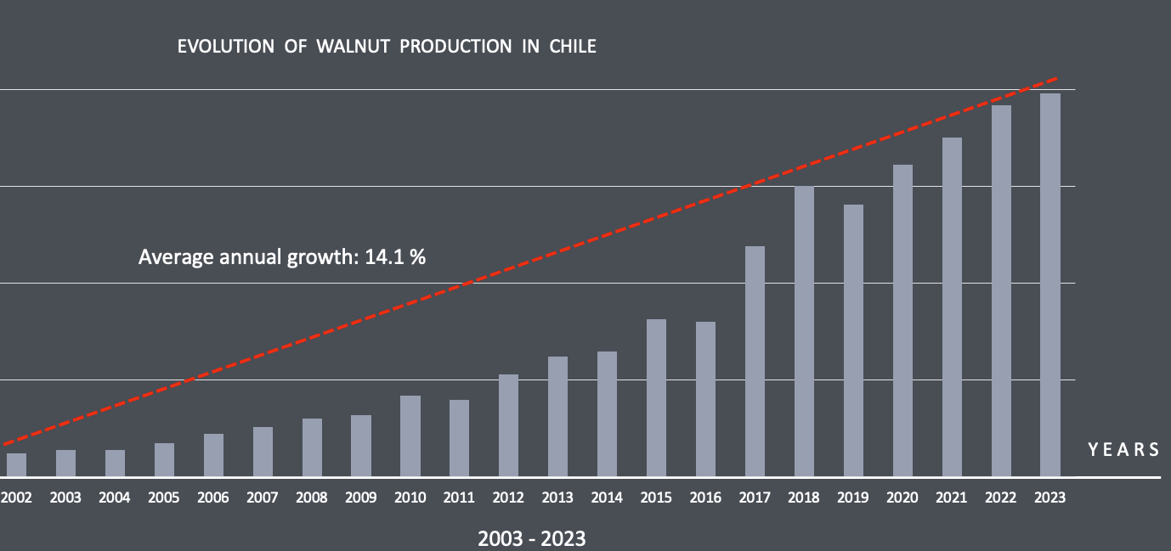
EVOLUTION OF
MOLDOVAN WALNUT PRODUCTION (in-shell basis), metric tons)
Year | 1992 | 1993 | 1994 | 1995 | 1996 | 1997 | 1998 | 1999 | 2000 | 2001 | 2002 | 2003 | 2004 | 2005 | 2006 | 2007
Production( tons) | 11,273 | 19,800 | 15,050 | 7,338 | 6,303 | 5,668 | 10,490 | 6,530 | 5,992 | 7,494 | 13,898 | 17,991 | 17,917 | 13,369 | 10,780 | 10,092
History
of Walnut Production in
Status
REPUBLIC OF MOLDOVA
Year | 2008 | 2009 | 2010 | 2011 | 2012 | 2013 | 2014 | 2015 | 2016 | 2017 | 2018 | 2019 | 2020 | 2021 | 2022 | 2023
Production( tons | 13,742 | 9,829 | 11,583 | 14,016 | 9,062 | 12,688 | 13,115 | 11,036 | 13,825 | 18,520 | 18,247 | 17,706 | 14,669 | 19,125 | 19,120 | 20,590
Source:
FAOSTAT Food and Agriculture Organization (FAO)
YEARS | 2002 | 2003 | 2004 | 2005 | 2006 | 2007 | 2008 | 2009 | 2010 | 2011 | 2012 | 2013 | 2014 | 2015 | 2016 | 2017 | 2018 | 2019 | 2020 | 2021 | 2022 | 2023
METRIC TONS | 12,400 | 13,800 | 14,000 | 17,700 | 22,200 | 26,000 | 30,000 | 32,000 | 42,000 | 40,000 | 53,000 | 62,000 | 65,000 | 81,634 | 80,000 | 119,000 | 150,000 | 140,400 | 161,000 | 175,000 | 192,000 | 198,000
THE CURRENT STATE OF MOLDOVAN WALNUT PRODUCTION
IN 31 YEARS, 1992 - 2023
DOES MOLDOVA HOLD POTENTIAL
TO BE A STRONGER PLAYER?
1.8x
MURAT BADEM
Nisão NutVision
Production
Chișinău, February 27, 2025

Slide 5
INTERNATIONAL TRADE
INSHELL IMPORTS
INSHELL EXPORTS
History
of Walnut Production in
2020
2021
2022
2023
2020
2021
2022
2023
Status
Turkey | 321 | 211 | 1,047 | 1,265
Iraq | 155 |  |  | 297
Albania |  | 232 | 237 | 645
Romania |  |  |  | 453
France | 2,354 | 2,093 | 1,811 | 1,520
Ukraine | 113 | 342 | 647
REPUBLIC OF MOLDOVA
INSHELL IMPORTS
INSHELL EXPORTS
Year | 1992 | 1993 | 1994 | 1995 | 1996 | 1997 | 1998 | 1999 | 2000 | 2001 | 2002 | 2003 | 2004 | 2005 | 2006 | 2007
Productio | 11,273 | 19,800 | 15,050 | 7,338 | 6,303 | 5,668 | 10,490 | 6,530 | 5,992 | 7,494 | 13,898 | 17,991 | 17,917 | 13,369 | 10,780 | 10,092
AVG. PRICE PAID
France. ~2.00 $/kg
Ukraine. ~0.90 $/kg
TONS
AVG. PRICE RECEIVED
~ 2.40 $/kg
TONS
KERNEL IMPORTS
KERNEL EXPORTS
Year | 2008 | 2009 | 2010 | 2011 | 2012 | 2013 | 2014 | 2015 | 2016 | 2017 | 2018 | 2019 | 2020 | 2021 | 2022 | 2023
Productio | 13,742 | 9,829 | 11,583 | 14,016 | 9,062 | 12,688 | 13,115 | 11,036 | 13,825 | 18,520 | 18,247 | 17,706 | 14,669 | 19,125 | 19,120 | 20,590
2020
2021
2022
2023
2020
2021
2022
2023
Ukraine | 2,363 | 2,428 | 1,045 | 1,518
USA |  | 341 |  | 250
China |  | 351 | 838
Kyrgyzstan |  | 219 | 683
Uzbekistan |  |  | 160
France | 2,748 | 2,310 | 1,829 | 1,171
Germany | 2,713 | 1,922 | 1,687 | 1,554
Netherlands | 1,281 | 611 | 703
Austria | 824 | 803 | 759
Turkey |  |  |  | 707
Romania |  |  |  | 1,081
KERNEL IMPORTS
KERNEL EXPORTS
YEARS | 2002 | 2003 | 2004 | 2005 | 2006 | 2007 | 2008 | 2009 | 2010 | 2011 | 2012 | 2013 | 2014 | 2015 | 2016 | 2017 | 2018 | 2019 | 2020 | 2021 | 2022 | 2023
METRIC TONS | 12,400 | 13,800 | 14,000 | 17,700 | 22,200 | 26,000 | 30,000 | 32,000 | 42,000 | 40,000 | 53,000 | 62,000 | 65,000 | 81,634 | 80,000 | 119,000 | 150,000 | 140,400 | 161,000 | 175,000 | 192,000 | 198,000
AVG. PRICE PAID
Ukraine. ~ 2.40 $/kg
AVG. PRICE RECEIVED
~ 5.70 $/kg
THE CURRENT STATE OF MOLDOVAN WALNUT PRODUCTION
Source:
FAOSTAT. Food and Agriculture Organization (FAO)
DOES MOLDOVA HOLD POTENTIAL
TO BE A STRONGER PLAYER?
MURAT BADEM
Nisão NutVision
Chișinău, February 27, 2025

Slide 6


Republic of Moldova´s Current
International Trade Model in Walnuts
is this a sustainable and growth oriented model ?
History
of Walnut Production in
Status
REPUBLIC OF MOLDOVA
Imports in-shell walnut France & Ukraine
Year | 1992 | 1993 | 1994 | 1995 | 1996 | 1997 | 1998 | 1999 | 2000 | 2001 | 2002 | 2003 | 2004 | 2005 | 2006 | 2007
Productio | 11,273 | 19,800 | 15,050 | 7,338 | 6,303 | 5,668 | 10,490 | 6,530 | 5,992 | 7,494 | 13,898 | 17,991 | 17,917 | 13,369 | 10,780 | 10,092
Imports lower quality kernels from Ukraine
Use labor to shell own and imported in-shell walnuts & reprocess Ukrainian kernels to convert into higher quality kernels
Dependent on recovery in Ukraine
Year | 2008 | 2009 | 2010 | 2011 | 2012 | 2013 | 2014 | 2015 | 2016 | 2017 | 2018 | 2019 | 2020 | 2021 | 2022 | 2023
Productio | 13,742 | 9,829 | 11,583 | 14,016 | 9,062 | 12,688 | 13,115 | 11,036 | 13,825 | 18,520 | 18,247 | 17,706 | 14,669 | 19,125 | 19,120 | 20,590
Sell high quality kernels to EU
Sell medium quality in-shell to Turkey, Albaia, Iraq and Romania
YEARS | 2002 | 2003 | 2004 | 2005 | 2006 | 2007 | 2008 | 2009 | 2010 | 2011 | 2012 | 2013 | 2014 | 2015 | 2016 | 2017 | 2018 | 2019 | 2020 | 2021 | 2022 | 2023
METRIC TONS | 12,400 | 13,800 | 14,000 | 17,700 | 22,200 | 26,000 | 30,000 | 32,000 | 42,000 | 40,000 | 53,000 | 62,000 | 65,000 | 81,634 | 80,000 | 119,000 | 150,000 | 140,400 | 161,000 | 175,000 | 192,000 | 198,000
Transforming Ukrainian Walnut to better quality products
THE CURRENT STATE OF MOLDOVAN WALNUT PRODUCTION
DOES MOLDOVA HOLD POTENTIAL
TO BE A STRONGER PLAYER?
MURAT BADEM
Nisão NutVision
Chișinău, February 27, 2025

Slide 7
International Trade Model in Walnuts
metric tons
Exports | 2015 | 2016 | 2017 | 2018 | 2019 | 2020 | 2021 | 2022 | 2023
Walnuts, in shell | 1,189 | 1,749 | 1,296 | 1,027 | 2,573 | 674 | 569 | 1,449 | 2,921
Walnuts, shelled | 13,793 | 13,686 | 13,564 | 13,034 | 15,836 | 11,915 | 8,403 | 8,169 | 7,534
of Walnut Production in
Status
Imports | 2015 | 2016 | 2017 | 2018 | 2019 | 2020 | 2021 | 2022 | 2023
Walnuts, in shell | 2,680 | 3,115 | 3,561 | 3,907 | 2,913 | 2,501 | 2,435 | 2,479 | 1,520
Walnuts, shelled | 1,578 | 1,239 | 1,390 | 2,440 | 3,453 | 2,364 | 3,521 | 2,837 | 1,936
REPUBLIC OF MOLDOVA
Net Importer
Trade Balance | 2015 | 2016 | 2017 | 2018 | 2019 | 2020 | 2021 | 2022 | 2023
Walnuts, in shell | -1,491 | -1,366 | -2,265 | -2,881 | -339 | -1,827 | -1,866 | -1,030 | 1,401
Walnuts, shelled | 12,215 | 12,448 | 12,174 | 10,594 | 12,383 | 9,551 | 4,882 | 5,332 | 5,598
Net Exporter
Year | 2008 | 2009 | 2010 | 2011 | 2012 | 2013 | 2014 | 2015 | 2016 | 2017 | 2018 | 2019 | 2020 | 2021 | 2022 | 2023
Productio | 13,742 | 9,829 | 11,583 | 14,016 | 9,062 | 12,688 | 13,115 | 11,036 | 13,825 | 18,520 | 18,247 | 17,706 | 14,669 | 19,125 | 19,120 | 20,590
Inshell Equivalent | 25,654 | 26,295 | 24,789 | 20,662 | 27,179 | 19,398 | 8,982 | 10,819 | 13,841
THE CURRENT STATE OF MOLDOVAN WALNUT PRODUCTION
DOES MOLDOVA HOLD POTENTIAL
TO BE A STRONGER PLAYER?
MURAT BADEM
Nisão NutVision
Chișinău, February 27, 2025

Slide 8
Two Success Stories
CALIFORNIA
CHILE
# 1 Global Walnut Exporter
# 3 Global Walnut Exporter
2024/2025 Exports
440,000 metric tons
2024/2025 Exports
190,000 metric tons
THE CURRENT STATE OF MOLDOVAN WALNUT PRODUCTION
DOES MOLDOVA HOLD POTENTIAL
TO BE A STRONGER PLAYER?
MURAT BADEM
Nisão NutVision
Chișinău, February 27, 2025

Slide 9
First Walnut Plants brought to California by Spanish missionaries in late 1770 s
First commercial walnut nursery established, in 1867
Southern California Walnut Growers Association established in 1896
History of Walnut Production in
University of California, Davis (UC Davis) in 1905
The California Walnut Board, established in 1948
CALIFORNIA
Chandler and Hartley Varieries introduced in 1979
THE CURRENT STATE OF MOLDOVAN WALNUT PRODUCTION
DOES MOLDOVA HOLD POTENTIAL
TO BE A STRONGER PLAYER?
MURAT BADEM
Nisão NutVision
Chișinău, February 27, 2025

Slide 10
First Walnut Plants brought to California by Spanish missionaries in late 1770 s
First commercial walnut nursery established, in 1867
Southern California Walnut Growers Association established in 1896
University of California, Davis (UC Davis) in 1905
Chandler and Hartley Varieries introduced in 1979
Metric tons
History of Walnut Production in
CALIFORNIA
1920-1960
1987 - 2024
Y E A R S
Source:
United States Department of Agriculture
National Agricultural Statistics Service
Year | 1920 | 1930 | 1940 | 1950 | 1987 | 1988 | 1989 | 1990 | 1991 | 1992 | 1993 | 1994 | 1995 | 1996 | 1997 | 1998 | 1999 | 2000 | 2001 | 2002 | 2003
tons | 23,000 | 36,000 | 41,000 | 37,000 | 223,000 | 186,000 | 189,000 | 188,000 | 189,000 | 216,000 | 216,000 | 216,000 | 211,000 | 243,000 | 243,000 | 255,000 | 255,000 | 216,000 | 254,000 | 254,000 | 294,000
Year | 2004 | 2005 | 2006 | 2007 | 2008 | 2009 | 2010 | 2011 | 2012 | 2013 | 2014 | 2015 | 2016 | 2017 | 2018 | 2019 | 2020 | 2021 | 2022 | 2023 | 2024
tons | 293,000 | 320,000 | 312,000 | 296,000 | 393,000 | 394,000 | 454,000 | 415,000 | 448,000 | 443,000 | 514,000 | 546,000 | 621,000 | 567,000 | 612,000 | 590,000 | 711,000 | 660,000 | 677,000 | 742,000 | 603,000
THE CURRENT STATE OF MOLDOVAN WALNUT PRODUCTION
DOES MOLDOVA HOLD POTENTIAL
TO BE A STRONGER PLAYER?
MURAT BADEM
Nisão NutVision
Chișinău, February 27, 2025

Slide 11
First commercial Walnut Orchards established in late 1990s
The Chilean Walnut Growers & Exporters Association established, in 2002
Chilean in-shell walnuts enter the Chinese market 2014
History of Walnut Production in
Chilean kernel walnuts enter the Chinese market 2016
CHILE
Chile becomes the 2nd largest walnut exporter after United States in 2015
THE CURRENT STATE OF MOLDOVAN WALNUT PRODUCTION
DOES MOLDOVA HOLD POTENTIAL
TO BE A STRONGER PLAYER?
MURAT BADEM
Nisão NutVision
Chișinău, February 27, 2025

Slide 12

of Walnut Production in
History
Metric tons
CHILE
Average annual growth: 14.1 %
Average annual growth: 3.4 %
Y E A R S
1994 – 2002
2003 - 2023
YEARS
1994 | 1995 | 1996 | 1997 | 1998 | 1999 | 2000 | 2001 | 2002 | 2003 | 2004 | 2005 | 2006 | 2007 | 2008
9,500 | 9,800 | 8,800 | 10,950 | 9,955 | 12,000 | 10,000 | 11,800 | 12,400 | 13,800 | 14,000 | 17,700 | 22,200 | 26,000 | 30,000
THE CURRENT STATE OF MOLDOVAN WALNUT PRODUCTION
METRIC TONS
YEARS
2009 | 2010 | 2011 | 2012 | 2013 | 2014 | 2015 | 2016 | 2017 | 2018 | 2019 | 2020 | 2021 | 2022 | 2023
32,000 | 42,000 | 40,000 | 53,000 | 62,000 | 65,000 | 81,634 | 80,000 | 119,000 | 150,000 | 140,400 | 161,000 | 175,000 | 192,000 | 198,000
DOES MOLDOVA HOLD POTENTIAL
TO BE A STRONGER PLAYER?
METRIC TONS
MURAT BADEM
Nisão NutVision
Source:
ChileNut
United States Department of Agriculture
National Agricultural Statistics Service
Chișinău, February 27, 2025

Slide 13
Status
of Walnut Production in
History
CHILE
YEARS | 2002 | 2003 | 2004 | 2005 | 2006 | 2007 | 2008 | 2009 | 2010 | 2011 | 2012 | 2013 | 2014 | 2015 | 2016 | 2017 | 2018 | 2019 | 2020 | 2021 | 2022 | 2023
METRIC TONS | 12,400 | 13,800 | 14,000 | 17,700 | 22,200 | 26,000 | 30,000 | 32,000 | 42,000 | 40,000 | 53,000 | 62,000 | 65,000 | 81,634 | 80,000 | 119,000 | 150,000 | 140,400 | 161,000 | 175,000 | 192,000 | 198,000
IN 22 YEARS, BETWEEN 2002 - 2023
THE CURRENT STATE OF MOLDOVAN WALNUT PRODUCTION
16 x
15 x
Production
Exports
DOES MOLDOVA HOLD POTENTIAL
TO BE A STRONGER PLAYER?
MURAT BADEM
Nisão NutVision
Chișinău, February 27, 2025

Slide 14
ELABORATING ON MOLDOVA´S
REALISTIC POTENTIAL
History
of Walnut Production in
Potantial
REPUBLIC OF MOLDOVA
MSC IRINA
Year | 1992 | 1993 | 1994 | 1995 | 1996 | 1997 | 1998 | 1999 | 2000 | 2001 | 2002 | 2003 | 2004 | 2005 | 2006 | 2007
Productio | 11,273 | 19,800 | 15,050 | 7,338 | 6,303 | 5,668 | 10,490 | 6,530 | 5,992 | 7,494 | 13,898 | 17,991 | 17,917 | 13,369 | 10,780 | 10,092
LARGEST OCEAN
CONTAINER SHIP
Year | 2008 | 2009 | 2010 | 2011 | 2012 | 2013 | 2014 | 2015 | 2016 | 2017 | 2018 | 2019 | 2020 | 2021 | 2022 | 2023
Productio | 13,742 | 9,829 | 11,583 | 14,016 | 9,062 | 12,688 | 13,115 | 11,036 | 13,825 | 18,520 | 18,247 | 17,706 | 14,669 | 19,125 | 19,120 | 20,590
IN THE WORLD
AS OF JAN 2015
YEARS | 2002 | 2003 | 2004 | 2005 | 2006 | 2007 | 2008 | 2009 | 2010 | 2011 | 2012 | 2013 | 2014 | 2015 | 2016 | 2017 | 2018 | 2019 | 2020 | 2021 | 2022 | 2023
METRIC TONS | 12,400 | 13,800 | 14,000 | 17,700 | 22,200 | 26,000 | 30,000 | 32,000 | 42,000 | 40,000 | 53,000 | 62,000 | 65,000 | 81,634 | 80,000 | 119,000 | 150,000 | 140,400 | 161,000 | 175,000 | 192,000 | 198,000
THE CURRENT STATE OF MOLDOVAN WALNUT PRODUCTION
DOES MOLDOVA HOLD POTENTIAL
TO BE A STRONGER PLAYER?
MURAT BADEM
Nisão NutVision
Chișinău, February 27, 2025

Slide 15


MSC IRINA
History
of Walnut Production in
Status
REPUBLIC OF MOLDOVA
Year | 1992 | 1993 | 1994 | 1995 | 1996 | 1997 | 1998 | 1999 | 2000 | 2001 | 2002 | 2003 | 2004 | 2005 | 2006 | 2007
Productio | 11,273 | 19,800 | 15,050 | 7,338 | 6,303 | 5,668 | 10,490 | 6,530 | 5,992 | 7,494 | 13,898 | 17,991 | 17,917 | 13,369 | 10,780 | 10,092
Year | 2008 | 2009 | 2010 | 2011 | 2012 | 2013 | 2014 | 2015 | 2016 | 2017 | 2018 | 2019 | 2020 | 2021 | 2022 | 2023
Productio | 13,742 | 9,829 | 11,583 | 14,016 | 9,062 | 12,688 | 13,115 | 11,036 | 13,825 | 18,520 | 18,247 | 17,706 | 14,669 | 19,125 | 19,120 | 20,590
61.3 m
YEARS | 2002 | 2003 | 2004 | 2005 | 2006 | 2007 | 2008 | 2009 | 2010 | 2011 | 2012 | 2013 | 2014 | 2015 | 2016 | 2017 | 2018 | 2019 | 2020 | 2021 | 2022 | 2023
METRIC TONS | 12,400 | 13,800 | 14,000 | 17,700 | 22,200 | 26,000 | 30,000 | 32,000 | 42,000 | 40,000 | 53,000 | 62,000 | 65,000 | 81,634 | 80,000 | 119,000 | 150,000 | 140,400 | 161,000 | 175,000 | 192,000 | 198,000
399.9 m
THE CURRENT STATE OF MOLDOVAN WALNUT PRODUCTION
DOES MOLDOVA HOLD POTENTIAL
TO BE A STRONGER PLAYER?
MURAT BADEM
Nisão NutVision
Chișinău, February 27, 2025

Slide 16

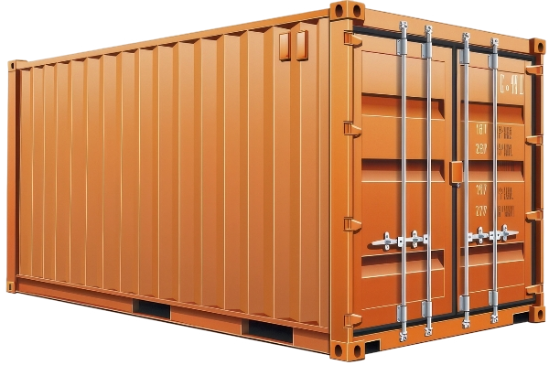

History
of Walnut Production in
Status
REPUBLIC OF MOLDOVA
Year | 1992 | 1993 | 1994 | 1995 | 1996 | 1997 | 1998 | 1999 | 2000 | 2001 | 2002 | 2003 | 2004 | 2005 | 2006 | 2007
Productio | 11,273 | 19,800 | 15,050 | 7,338 | 6,303 | 5,668 | 10,490 | 6,530 | 5,992 | 7,494 | 13,898 | 17,991 | 17,917 | 13,369 | 10,780 | 10,092
MSC IRINA
Capacity
2
4
3
4
6
|
20'
,
containers
Year | 2008 | 2009 | 2010 | 2011 | 2012 | 2013 | 2014 | 2015 | 2016 | 2017 | 2018 | 2019 | 2020 | 2021 | 2022 | 2023
Productio | 13,742 | 9,829 | 11,583 | 14,016 | 9,062 | 12,688 | 13,115 | 11,036 | 13,825 | 18,520 | 18,247 | 17,706 | 14,669 | 19,125 | 19,120 | 20,590
61.3 m
YEARS | 2002 | 2003 | 2004 | 2005 | 2006 | 2007 | 2008 | 2009 | 2010 | 2011 | 2012 | 2013 | 2014 | 2015 | 2016 | 2017 | 2018 | 2019 | 2020 | 2021 | 2022 | 2023
METRIC TONS | 12,400 | 13,800 | 14,000 | 17,700 | 22,200 | 26,000 | 30,000 | 32,000 | 42,000 | 40,000 | 53,000 | 62,000 | 65,000 | 81,634 | 80,000 | 119,000 | 150,000 | 140,400 | 161,000 | 175,000 | 192,000 | 198,000
399.9 m
THE CURRENT STATE OF MOLDOVAN WALNUT PRODUCTION
DOES MOLDOVA HOLD POTENTIAL
TO BE A STRONGER PLAYER?
MURAT BADEM
Nisão NutVision
Chișinău, February 27, 2025

Slide 17
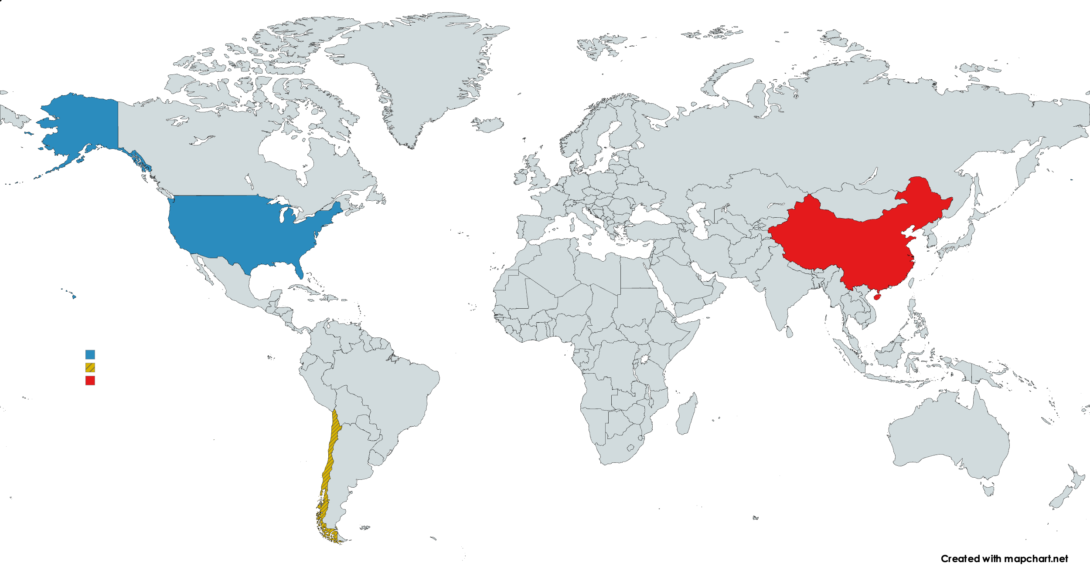


GLOBAL WALNUT
of Walnut Production in
PRODUCTION
History
Status
+ 2,700,000 tons
REPUBLIC OF MOLDOVA
Producer | Production
China | 1,500,000
United States | 607,813
Chile | 195,000
EU | 150,000
Ukraine | 100,000
Turkey | 67,000
India | 34,000
Other | 41,000
Total | tons 2,694,813
Year | 1992 | 1993 | 1994 | 1995 | 1996 | 1997 | 1998 | 1999 | 2000 | 2001 | 2002 | 2003 | 2004 | 2005 | 2006 | 2007
Productio | 11,273 | 19,800 | 15,050 | 7,338 | 6,303 | 5,668 | 10,490 | 6,530 | 5,992 | 7,494 | 13,898 | 17,991 | 17,917 | 13,369 | 10,780 | 10,092
MSC IRINA
Capacity
2
4
3
4
6
|
20'
CHINA
+ USA
+ CHILE
,
containers
+ 2,300,000 tons
85.5 %
global supply
Year | 2008 | 2009 | 2010 | 2011 | 2012 | 2013 | 2014 | 2015 | 2016 | 2017 | 2018 | 2019 | 2020 | 2021 | 2022 | 2023
Productio | 13,742 | 9,829 | 11,583 | 14,016 | 9,062 | 12,688 | 13,115 | 11,036 | 13,825 | 18,520 | 18,247 | 17,706 | 14,669 | 19,125 | 19,120 | 20,590
in-shell, dry basis, Marketing Year 2024
TOP 2 IMPORTERS
40.4 %
61.3 m
YEARS | 2002 | 2003 | 2004 | 2005 | 2006 | 2007 | 2008 | 2009 | 2010 | 2011 | 2012 | 2013 | 2014 | 2015 | 2016 | 2017 | 2018 | 2019 | 2020 | 2021 | 2022 | 2023
METRIC TONS | 12,400 | 13,800 | 14,000 | 17,700 | 22,200 | 26,000 | 30,000 | 32,000 | 42,000 | 40,000 | 53,000 | 62,000 | 65,000 | 81,634 | 80,000 | 119,000 | 150,000 | 140,400 | 161,000 | 175,000 | 192,000 | 198,000
GLOBAL WALNUT
EXPORTS
global exports
310,000 t.
435,000 t.
399.9 m
THE CURRENT STATE OF MOLDOVAN WALNUT PRODUCTION
1,100,000 tons
Largest 2 importers EU and Turkey
125,000 t.
Covers 40 % of global export market
DOES MOLDOVA HOLD POTENTIAL
TO BE A STRONGER PLAYER?
44,000
|
20'
MURAT BADEM
Nisão NutVision
435,000 t.
containers
Chișinău, February 27, 2025

Slide 18
History
of Walnut Production in
Status
REPUBLIC OF MOLDOVA
TOP 2 IMPORTERS
Year | 1992 | 1993 | 1994 | 1995 | 1996 | 1997 | 1998 | 1999 | 2000 | 2001 | 2002 | 2003 | 2004 | 2005 | 2006 | 2007
Productio | 11,273 | 19,800 | 15,050 | 7,338 | 6,303 | 5,668 | 10,490 | 6,530 | 5,992 | 7,494 | 13,898 | 17,991 | 17,917 | 13,369 | 10,780 | 10,092
MSC IRINA
Capacity
2
4
3
4
6
|
310,000 t.
,
20'
containers
125,000 t.
Year | 2008 | 2009 | 2010 | 2011 | 2012 | 2013 | 2014 | 2015 | 2016 | 2017 | 2018 | 2019 | 2020 | 2021 | 2022 | 2023
Productio | 13,742 | 9,829 | 11,583 | 14,016 | 9,062 | 12,688 | 13,115 | 11,036 | 13,825 | 18,520 | 18,247 | 17,706 | 14,669 | 19,125 | 19,120 | 20,590
435,000 t.
44,000
|
20'
containers
61.3 m
YEARS | 2002 | 2003 | 2004 | 2005 | 2006 | 2007 | 2008 | 2009 | 2010 | 2011 | 2012 | 2013 | 2014 | 2015 | 2016 | 2017 | 2018 | 2019 | 2020 | 2021 | 2022 | 2023
METRIC TONS | 12,400 | 13,800 | 14,000 | 17,700 | 22,200 | 26,000 | 30,000 | 32,000 | 42,000 | 40,000 | 53,000 | 62,000 | 65,000 | 81,634 | 80,000 | 119,000 | 150,000 | 140,400 | 161,000 | 175,000 | 192,000 | 198,000
2 x
MSC IRINA
399.9 m
THE CURRENT STATE OF MOLDOVAN WALNUT PRODUCTION
Largest 2 importers EU and Turkey
Covers 40 % of global export market
DOES MOLDOVA HOLD POTENTIAL
TO BE A STRONGER PLAYER?
MURAT BADEM
Nisão NutVision
Chișinău, February 27, 2025

Slide 19
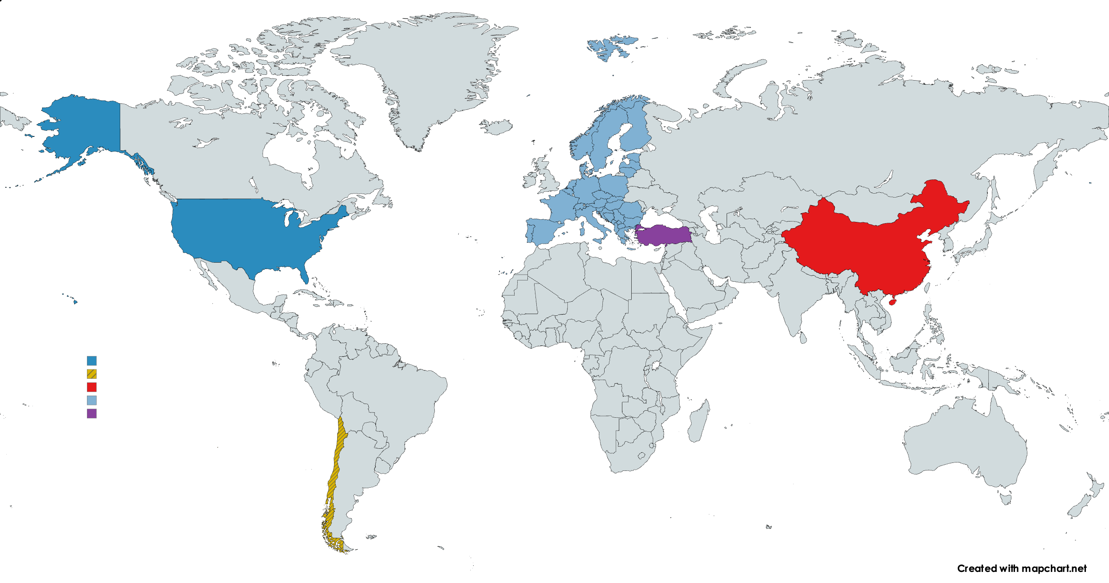

History
of Walnut Production in
Status
REPUBLIC OF MOLDOVA
Year | 1992 | 1993 | 1994 | 1995 | 1996 | 1997 | 1998 | 1999 | 2000 | 2001 | 2002 | 2003 | 2004 | 2005 | 2006 | 2007
Productio | 11,273 | 19,800 | 15,050 | 7,338 | 6,303 | 5,668 | 10,490 | 6,530 | 5,992 | 7,494 | 13,898 | 17,991 | 17,917 | 13,369 | 10,780 | 10,092
Year | 2008 | 2009 | 2010 | 2011 | 2012 | 2013 | 2014 | 2015 | 2016 | 2017 | 2018 | 2019 | 2020 | 2021 | 2022 | 2023
Productio | 13,742 | 9,829 | 11,583 | 14,016 | 9,062 | 12,688 | 13,115 | 11,036 | 13,825 | 18,520 | 18,247 | 17,706 | 14,669 | 19,125 | 19,120 | 20,590
61.3 m
YEARS | 2002 | 2003 | 2004 | 2005 | 2006 | 2007 | 2008 | 2009 | 2010 | 2011 | 2012 | 2013 | 2014 | 2015 | 2016 | 2017 | 2018 | 2019 | 2020 | 2021 | 2022 | 2023
METRIC TONS | 12,400 | 13,800 | 14,000 | 17,700 | 22,200 | 26,000 | 30,000 | 32,000 | 42,000 | 40,000 | 53,000 | 62,000 | 65,000 | 81,634 | 80,000 | 119,000 | 150,000 | 140,400 | 161,000 | 175,000 | 192,000 | 198,000
399.9 m
THE CURRENT STATE OF MOLDOVAN WALNUT PRODUCTION
Largest 2 importers EU and Turkey
Covers 40 % of global export market
DOES MOLDOVA HOLD POTENTIAL
TO BE A STRONGER PLAYER?
MURAT BADEM
Nisão NutVision
Chișinău, February 27, 2025

Slide 20
History
of Walnut Production in
Status
REPUBLIC OF MOLDOVA
Year | 1992 | 1993 | 1994 | 1995 | 1996 | 1997 | 1998 | 1999 | 2000 | 2001 | 2002 | 2003 | 2004 | 2005 | 2006 | 2007
Productio | 11,273 | 19,800 | 15,050 | 7,338 | 6,303 | 5,668 | 10,490 | 6,530 | 5,992 | 7,494 | 13,898 | 17,991 | 17,917 | 13,369 | 10,780 | 10,092
Year | 2008 | 2009 | 2010 | 2011 | 2012 | 2013 | 2014 | 2015 | 2016 | 2017 | 2018 | 2019 | 2020 | 2021 | 2022 | 2023
Productio | 13,742 | 9,829 | 11,583 | 14,016 | 9,062 | 12,688 | 13,115 | 11,036 | 13,825 | 18,520 | 18,247 | 17,706 | 14,669 | 19,125 | 19,120 | 20,590
61.3 m
YEARS | 2002 | 2003 | 2004 | 2005 | 2006 | 2007 | 2008 | 2009 | 2010 | 2011 | 2012 | 2013 | 2014 | 2015 | 2016 | 2017 | 2018 | 2019 | 2020 | 2021 | 2022 | 2023
METRIC TONS | 12,400 | 13,800 | 14,000 | 17,700 | 22,200 | 26,000 | 30,000 | 32,000 | 42,000 | 40,000 | 53,000 | 62,000 | 65,000 | 81,634 | 80,000 | 119,000 | 150,000 | 140,400 | 161,000 | 175,000 | 192,000 | 198,000
399.9 m
THE CURRENT STATE OF MOLDOVAN WALNUT PRODUCTION
Largest 2 importers EU and Turkey
Covers 40 % of global export market
DOES MOLDOVA HOLD POTENTIAL
TO BE A STRONGER PLAYER?
MURAT BADEM
Nisão NutVision
Chișinău, February 27, 2025

Slide 21
Based on our analisys of the current production and export figures, and our observation on orchards we have seen, realistic goals for Moldovan Walnut Industry are:
History
of Walnut Production in
Criteria
Level
Period
Status
REPUBLIC OF MOLDOVA
Production
40,000 - 60,000 tons
6-8 years
NET Exports
35,000 tons
3-4 years
Year | 1992 | 1993 | 1994 | 1995 | 1996 | 1997 | 1998 | 1999 | 2000 | 2001 | 2002 | 2003 | 2004 | 2005 | 2006 | 2007
Productio | 11,273 | 19,800 | 15,050 | 7,338 | 6,303 | 5,668 | 10,490 | 6,530 | 5,992 | 7,494 | 13,898 | 17,991 | 17,917 | 13,369 | 10,780 | 10,092
What are the strategic priorities to reach these goals:
Year | 2008 | 2009 | 2010 | 2011 | 2012 | 2013 | 2014 | 2015 | 2016 | 2017 | 2018 | 2019 | 2020 | 2021 | 2022 | 2023
Productio | 13,742 | 9,829 | 11,583 | 14,016 | 9,062 | 12,688 | 13,115 | 11,036 | 13,825 | 18,520 | 18,247 | 17,706 | 14,669 | 19,125 | 19,120 | 20,590
Improve Productivity,
Improve Quality
(REAL AND CONCEIVED)
Improve Cost Competitiveness through Technology (NOT LABOR)
Take industry wide initiatives to help improve productivity to 4 tons/ha
Standardize varieties
Improve productivity
Improve fertitagion and irrigation control
Faster and earlier harvesting
Use technology to lower energy consumption and labor use
61.3 m
YEARS | 2002 | 2003 | 2004 | 2005 | 2006 | 2007 | 2008 | 2009 | 2010 | 2011 | 2012 | 2013 | 2014 | 2015 | 2016 | 2017 | 2018 | 2019 | 2020 | 2021 | 2022 | 2023
METRIC TONS | 12,400 | 13,800 | 14,000 | 17,700 | 22,200 | 26,000 | 30,000 | 32,000 | 42,000 | 40,000 | 53,000 | 62,000 | 65,000 | 81,634 | 80,000 | 119,000 | 150,000 | 140,400 | 161,000 | 175,000 | 192,000 | 198,000
Pollination
Improve processing, drying, calibration and QA
Mechanical harvesting
IPM – Integrated Pest Management
Introduce Shared Quality Standards
399.9 m
THE CURRENT STATE OF MOLDOVAN WALNUT PRODUCTION
Largest 2 importers EU and Turkey
Covers 40 % of global export market
DOES MOLDOVA HOLD POTENTIAL
TO BE A STRONGER PLAYER?
MURAT BADEM
Nisão NutVision
Chișinău, February 27, 2025

Slide 22
Definition of a “Commercial Orchard”:
DISCLAIMER:
The project „Promoting Green Deal Readiness in the Eastern Partnership Countries” (PROGRESS) is funded by the International Climate Initiative (IKI) of the German Federal Government and is implemented by the Deutsche Gesellschaft für Internationale Zusammenarbeit (GIZ) GmbH, as the lead agency, in partnership with the Organisation for Economic Co-operation and Development (OECD), the Regional Environmental Centre for the Caucasus (RECC), the European Business Association (EBA) Moldova and the Institute for Economics and Forecasting of the National Academy of Sciences of Ukraine (IEF).

Slide 23
MURAT BADEM
Managing Director
Thank you
Nisão NutVision
Chișinău, February 27, 2025

