Slide 1

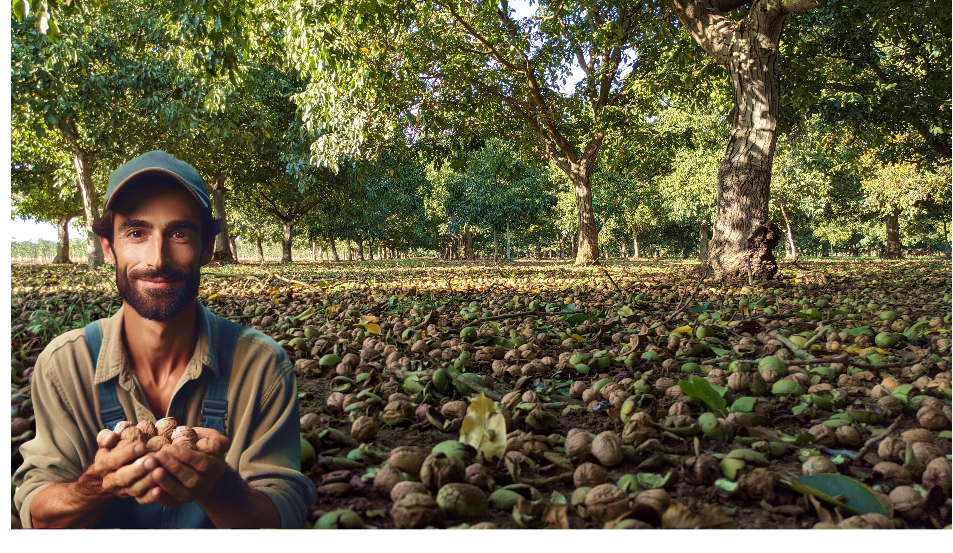


ESTABLISHING
A MODERN
WALNUT
ORCHARD
AND ITS MANAGEMENT
IN THE FIRST YEARS
Nisão NutVision
Smart and green technologies for climate adaptation
Chișinău, February 27, 2025

Slide 2
Copyright Statement
© 2025 Nisão, Lda. All rights reserved.
This presentation has been prepared by Nisão, Lda to provide guidance on Walnut Production and insights into the state of Global Walnut Markets. Information sources for the data provided have been included in relevant sections. While every effort has been made to ensure the accuracy of the information presented, Nisão, Lda does not accept any responsibility for the accuracy or currency of the data provided.
This document is protected by copyright and may not be reproduced, distributed, or shared in any form, including electronic or printed formats, without the prior written consent of Nisão, Lda. Unauthorized use, duplication, or modification of this content is strictly prohibited.
For permissions or inquiries regarding the use of this material, please contact Nisão, Lda at nutvision@nisao.pt
Published on March 2025 on [website URL: https://nisao.pt]

Slide 3
Format: Focusing on common practices adapted by Commercial Walnut Orchards in California
Born in 1984, CA, USA
Residence : Tulare, CA, USA
Bachelors of Science in Agricultural Business from California State University Fresno
30 years experience in the walnut industry, since age 9
12 years ownership of walnut nursery,
20 years experience developing, managing and providing consultancy services for orchards.
JAMES D. OLSON
Director, Technical Advisory Services
Nisão
NutVision
ESTABLISHING
A MODERN
WALNUT
ORCHARD
JAMES D. OLSON
Nisão NutVision
Chișinău, February 27, 2025

Slide 4
Definition of a “Commercial Orchard”:
Format: Focusing on common practices adapted by Commercial Walnut Orchards in California
These are the proven practices that have contributed to the success of CA Walnut Industry. Yet, we also must also take into account certain factors, as drawing conclusions on the validity of all practices in CA may be misleading because of:
environmental
Differences
in
industry structure
market realities
Raise the question:
Why ?
ESTABLISHING
A MODERN
WALNUT
ORCHARD
JAMES D. OLSON
Nisão NutVision
Chișinău, February 27, 2025

Slide 5

Vital importance in planning, and correct set-up for long term success and elimination of problems
Definition of a “Commercial Orchard”:
“Commercial Orchard" is not a strict technical term but rather a discipline in walnut cultivation focused on: maximizing efficiency, yield, and profitability through strategic planning, specialized techniques, and sustainable management practices.
sustainable management practices.
Maximizing Yield and Quality,
Optimizing Cost Efficiency,
Enhancing Market Competitiveness,
Ensuring Long-Term Orchard Sustainability,
Reducing Risks & Improving Resilience,
Maximizing Value Addition through product offerings.
Why ?
common
objectives
by commercial orchards
Sustainable Commercial Success
Nature
A commercial orchard is established and managed to ensure an acceptable minimum level of these results.
Long-term sustainable productivity can only be achieved by preserving nature and its resources.
ESTABLISHING
A MODERN
WALNUT
ORCHARD
JAMES D. OLSON
Nisão NutVision
Chișinău, February 27, 2025

Slide 6
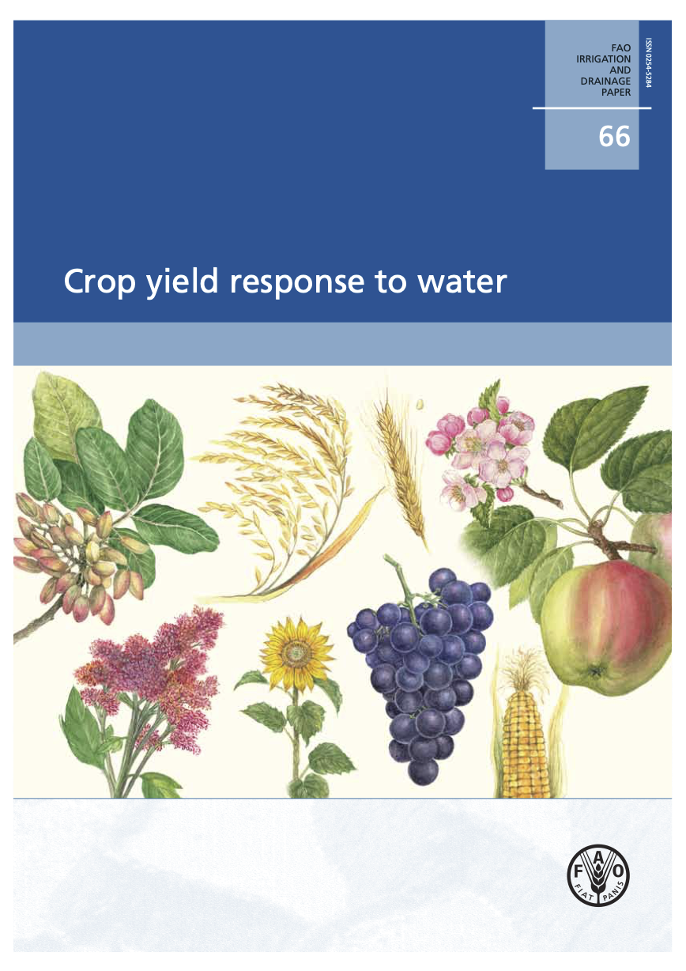
Vital importance in planning, and correct set-up for long term success and elimination of problems
Develop a clear understanding of your long term water need by learning important concepts such as ET_{c}
The foundation of a thriving walnut orchard is laid long before the first tree is planted.
Strategic planning and precise execution in the initial setup determine long-term productivity, sustainability, and financial success.
Learn about the effect of water on productivity and product quality.
Soil:
Learn how to make a water budget and to use it in the most effective and efficient way
Resources that needs to be secured in a long term perspective:
A commercial walnut orchard needs as much as 8,000 cubic meters per hectare per year.
Water needs to be to be of high quality, low salt levels and fairly neutral.
In many cases water issues can be corrected
High ph and lime issues can be corrected with acid titrated into water.
Some water has contaminants that can be precipitated or settled out by running water through an open pond.
Develop an understanding about how water moves in your soil and plants
Water:
Do not fool yourself
Long Term Water Security is arguably the most important resource needed to achieve commercial level productivity, quality and cost structure.
A valuable reference:
Crop Yield Respornse to Water – FAO.
Downloadable on Nisão-NutVision site
ESTABLISHING
A MODERN
WALNUT
ORCHARD
JAMES D. OLSON
Nisão NutVision
Chișinău, February 27, 2025

Slide 7

Resources that needs to be secured in a long term perspective:
Why ?
Know before deciding
Soil:
A
Information on macro and micronutrients
n effective and representative soil sampling is a must
Optimize fertilization proram
Assess Organic Matter & Structure
Evaluate Salinity, Drainage, Water Holding Capacity
Identify if any correction is needed
Repeat sampling Annually
Observe Results
Take Action
Growth,
Productivity
Fertilizer Plan
Soil Correction Plan
ESTABLISHING
A MODERN
WALNUT
ORCHARD
JAMES D. OLSON
Nisão NutVision
Chișinău, February 27, 2025

Slide 8

Resources that needs to be secured in a long term perspective:
Ph 6.5-8.0
Beware of deep free lime. Take some tests 1-1.5 meters deep and test for high free lime. In these cases walnuts will grow well for a few years but once roots get into high lime area will get sick and die depending on how concentrated the lime is.
Must be well drained, high water tables can cause same issue as high free lime in lower rot zone.
Structure: Sandy loam, loam, clayey loam are all excellent
Also check for Boron toxicity issues if have high boron levels.
Soil:
PREPARATION
& ORCHARD
DESIGN
Cover Crop
An effective cover crop strategy can produce many benefits.
IMPROVE YOUR SOIL & ITS BIOLOGICAL ACTIVITY
Why ?
By doing so, you can Improve Nutrient Availability and Efficiency of Fertilizer use.
Focus on:
Improve pH levels,
Improve Organic Material levels,
Improve CEC (Cation Exchange Capacity),
Use of Mycorrhizal Fungus,
Implement an effective Cover Crop strategy
Helps you use less inorganic fertilizers, with higher efficiency
ESTABLISHING
A MODERN
WALNUT
ORCHARD
JAMES D. OLSON
Nisão NutVision
Chișinău, February 27, 2025

Slide 9
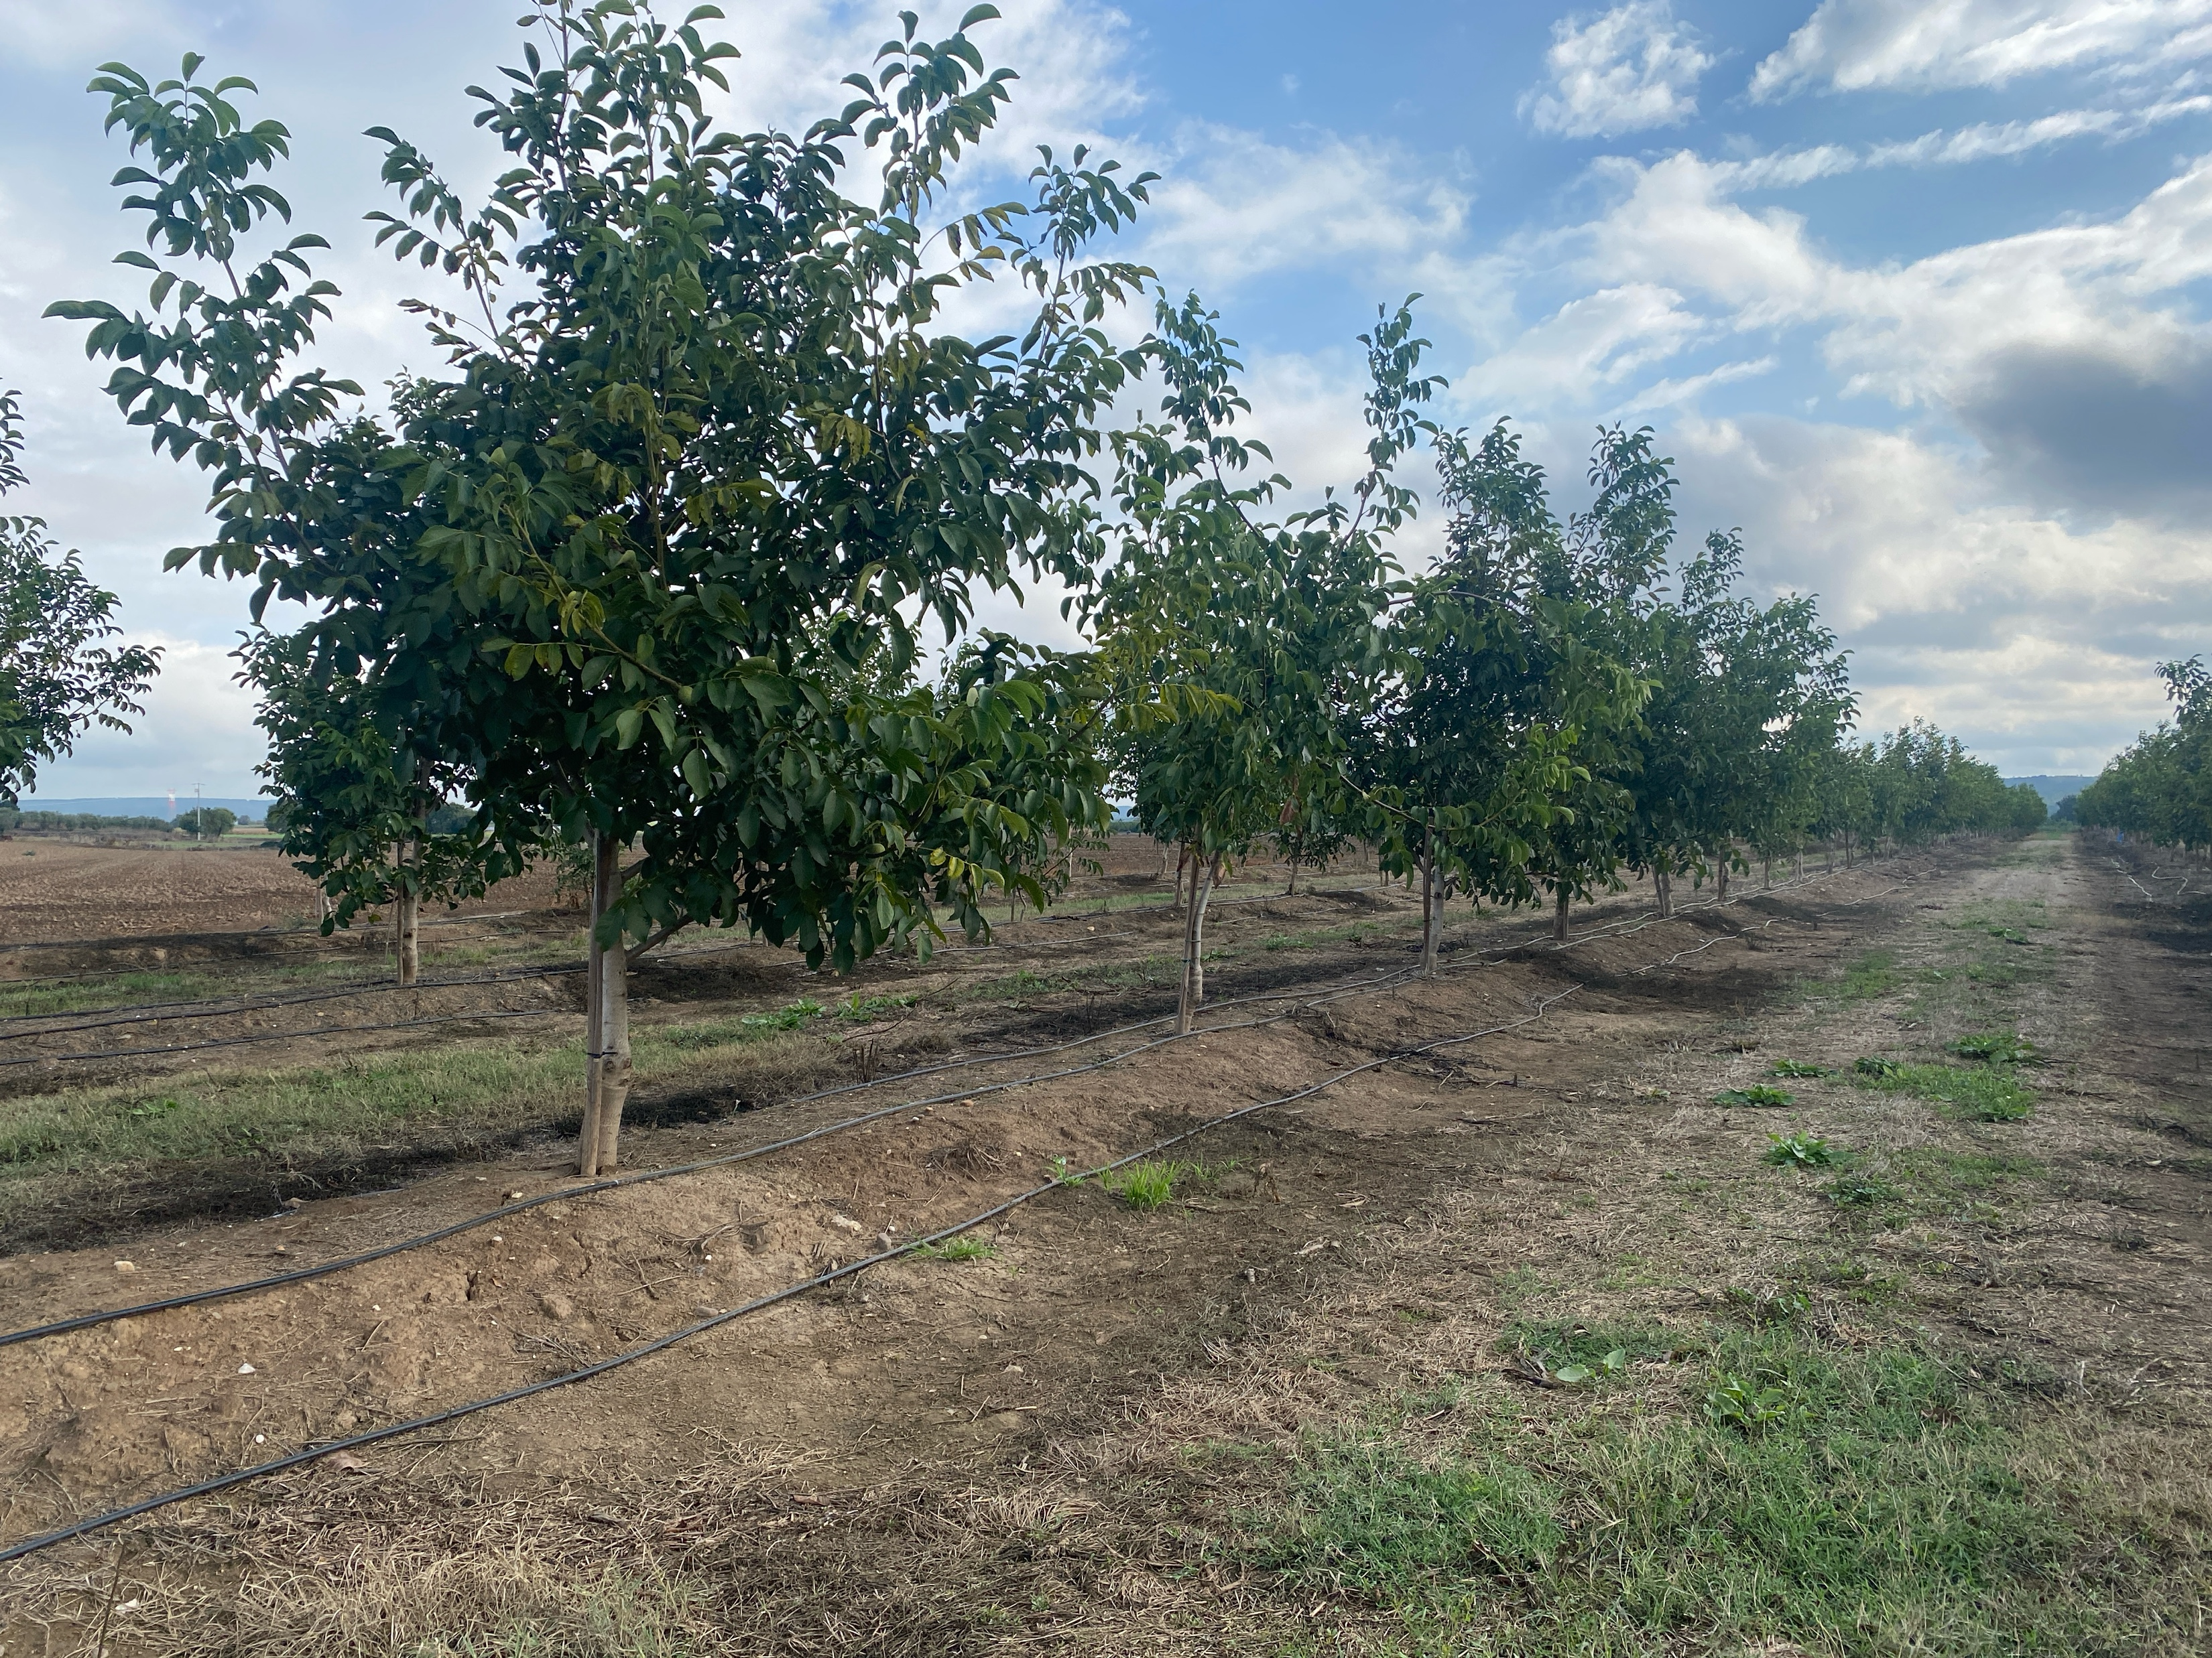
Resources that needs to be secured in a long term perspective:
Correct compactation of the top meter or so with subsoiling.
If leveling of soil is helpful, level ground.
Spacing: this should be determined by variety & rootstock and soil.
Start with a reference point of 6-7 meters between lines and 3 to 7 m between trees. Avoid extremes (in either side)
The more vigorous the rootstock and variety and the stronger the ground the wider the spacing.
For weaker ground, and less vigorous trees plant closer together.
Put in berms if advantageous to plant on borders.
Soil:
Irrigation system:
Preparation & Orchard Design
ESTABLISHING
A MODERN
WALNUT
ORCHARD
JAMES D. OLSON
Nisão NutVision
Chișinău, February 27, 2025
Planting in berms can be advantageous if have overly wet areas.

Slide 10

Resources that needs to be secured in a long term perspective:
Double line drip: most common and works well as long as well designed.
Single line drip: less expensive and can work well on heavier soils.
Why ?
Irrigation system:
Fanjets (micro sprinklers): most common in California. Can raise humidity and cause issues if water hitting tree trunks. If very hot and dry summer can use to lower temperatures in orchard if have adequate water
Irrigation system should be planned and installed, taking into account:
Correct dripper spacing and flow rate, according to the infiltration level of your soil,
With enough pumping flow-rate capable of delivering maximum amoun of water that each irrigation block will need when orchard reaches its full productivity,
Capable of delivering fertilizers for different orchard sections, with different measures determined by particular needs,
Operate Autonously based on irrigation scheduling, by controlling selenoid valves.
ESTABLISHING
A MODERN
WALNUT
ORCHARD
JAMES D. OLSON
Nisão NutVision
Chișinău, February 27, 2025

Slide 11
Resources that needs to be secured in a long term perspective:
In some geographies with suitable rainfall patterns it is possible to dry farm walnuts.
This has much lower costs but also much lower production
Inconsistent quality year to year.
Dry farmed walnuts will not consistently make quality standards required by world market standards.
Dry
production
Things to consider in Dry Production
In dry farming the water is the most important limiting factor,
Tree spacing should be wider, so that each tree will have a larger area to explore for water,
More vigorous varieties should give better results in more production.
SERR ?
ESTABLISHING
A MODERN
WALNUT
ORCHARD
JAMES D. OLSON
Nisão NutVision
Chișinău, February 27, 2025

Slide 12
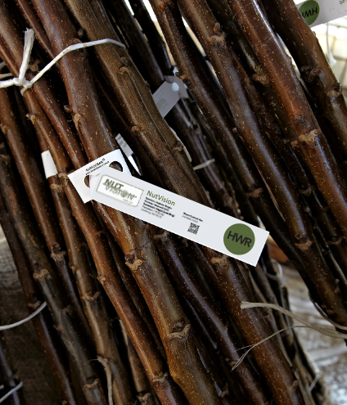
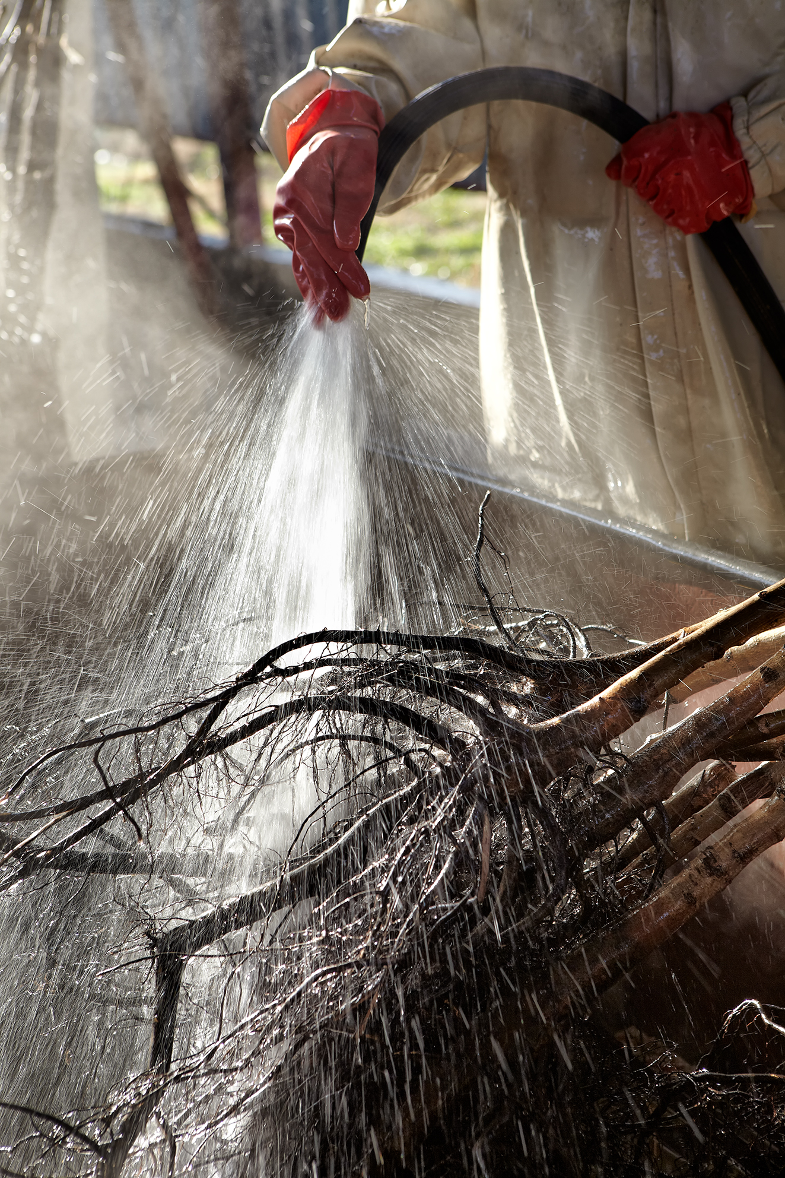
Resources that needs to be secured in a long term perspective:
If you consider yourself a football club owner, your plants are your players, your most important assets. Choose them well and treat them well.
Chose the right rootstock for your soil conditions,
Chose the right variety, and ensure that your plant nursery delivers them correctly,
Chose the right pollinators, in the right %, that will provide pollen availability in different maturity levels. Using more than one variety is highly recommended.
Start with good plants, with well developed and healthy root systems. Delay your plantation, if you cannot find good plants. Focus on root system rather than the wood development when buying plants.
Plant
s
Mistakes in pollinator
choice or inconsitencies.
by nurseries is the # .
reason for low
or delayed productivity
1
ESTABLISHING
A MODERN
WALNUT
ORCHARD
JAMES D. OLSON
Nisão NutVision
Chișinău, February 27, 2025
your plants are the stars of your orchard. Choose them well, treat them well !

Slide 13
Resources that needs to be secured in a long term perspective:
Varieties
to
consider
Pollinators
to
consider
Chandler,
Tulare,
Serr,
Franquette,
Fernette,
Ivarto,
Tehema
ESTABLISHING
A MODERN
WALNUT
ORCHARD
JAMES D. OLSON
Nisão NutVision
Chișinău, February 27, 2025

Slide 14
Resources that needs to be secured in a long term perspective:
Plant when trees in dormancy (prefer barerooted plants),
Plant high (grafting union should not be in contact with soil),
Avoid compact ground,
Don’t plant in mud,
Water trees once planted to collapse air pockets around roots,
Once planted and watered in no water until well leafed out.
Mark your pollinator varieties
Plant
ing
ESTABLISHING
A MODERN
WALNUT
ORCHARD
JAMES D. OLSON
Nisão NutVision
Chișinău, February 27, 2025

Slide 15
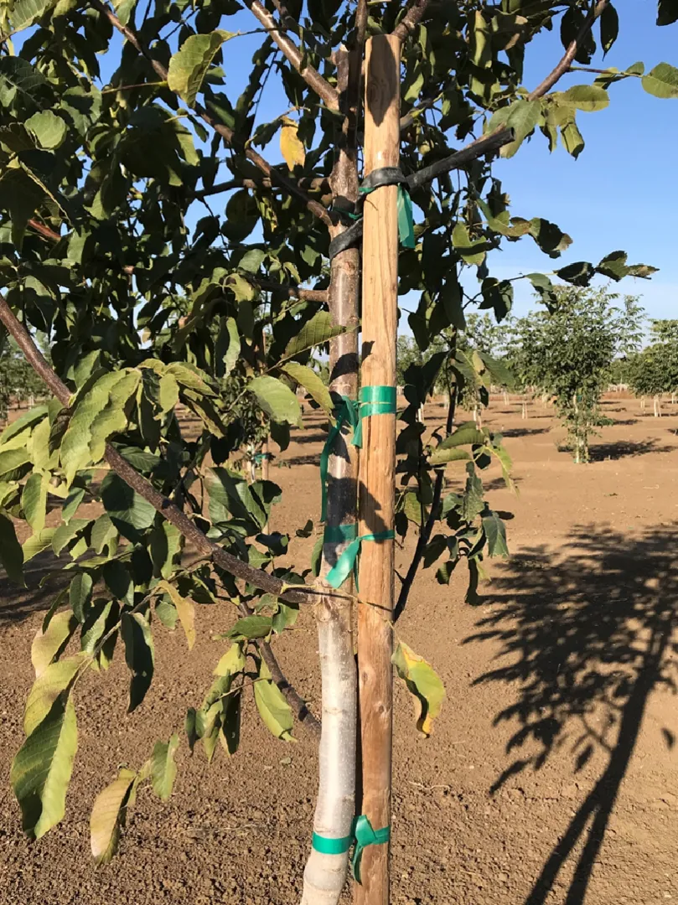
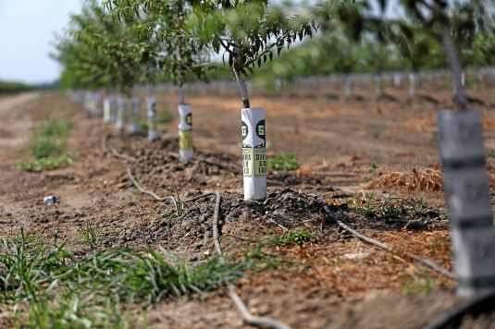
Plants should be supported by stakes to prevent breakages and to promote verticality,
Using bamboo sticks of 2.5 cm diameter is a very good practice,
Use elastic tape to tie the growing shoot on stake, to maintain vertical growth, repeat ties as growth continues,
Remove shoots that are coming out of the rootstock to conserve tree resources to the vertical growth,
In hot climates, painting young tree bark in white protects it from sunburn,
Eliminate competition with weeds around the root zone
Composted manure around tree, don’t pile around trunk,
15-15-15 works well also, especially in combination with compost,
Test for and correct any deficiencies of micro nutrients,
Be careful with nitrogen around young trees, it is easy to burn the roots with strong nitrogen, applications that can hurt your trees
Year 1
ESTABLISHING
A MODERN
WALNUT
ORCHARD
Staking helps avoid breakes, and maintains verticality
JAMES D. OLSON
Nisão NutVision
Chișinău, February 27, 2025
Tree protectors provide protection against, animals, sunburn and herbicide damage

Slide 16
Composted manure around tree, don’t pile around trunk,
15-15-15 works well also, especially in combination with compost,
Test for and correct any deficiencies of micro nutrients,
Be careful with nitrogen around young trees, it is easy to burn the roots with strong nitrogen, applications that can hurt your trees
In dry farming conditions, the total volume of macronutrients required will be lower. But the efficiency and the timing of applying them becomes more important.
Having nutrients available early in the season is vital.
Plants should be supported by stakes to prevent breakages and to promote verticality,
Using bamboo sticks of 2.5 cm diameter is a very good practice,
Use elastic tape to tie the growing shoot on stake, to maintain vertical growth, repeat ties as growth continues,
Remove shoots that are coming out of the rootstock to conserve tree resources to the vertical growth,
In hot climates, painting young tree bark in white protects it from sunburn,
Eliminate competition with weeds around the root zone
Year 1
ESTABLISHING
A MODERN
Tree protectors provide protection against, animals, sunburn and herbicide damage
WALNUT
ORCHARD
JAMES D. OLSON
Nisão NutVision
Chișinău, February 27, 2025

Slide 17
During the preparations, we cause intense disturbance to the ground. To ensure a long term sustainable production in your orchard:
Plants should be supported by stakes to prevent breakages and to promote verticality,
Using bamboo sticks of 2.5 cm diameter is a very good practice,
Use elastic tape to tie the growing shoot on stake, to maintain vertical growth, repeat ties as growth continues,
Remove shoots that are coming out of the rootstock to conserve tree resources to the vertical growth,
In hot climates, painting young tree bark in white protects it from sunburn,
Eliminate competition with weeds around the root zone
Soil health is very important. Cover crops, compost, humic acid or manure applications,
Reducing soil tillage is important also. We will occasionally need to till top couple inches to allow mechanized harvest. If done well should be 8-12 years between tillage events,
Cover crops grown in the winter can greatly help in maintaing soil health in orchard situations. Plant a diversity of species for best effects.
A well set up orchard with consistent cover crops and compost/manure applications will give the most resilience to changing climate conditions.
Irrigation
Early
Years
schedule
ESTABLISHING
A MODERN
Tree protectors provide protection against, animals, sunburn and herbicide damage
WALNUT
ORCHARD
JAMES D. OLSON
Nisão NutVision
Chișinău, February 27, 2025

Slide 18
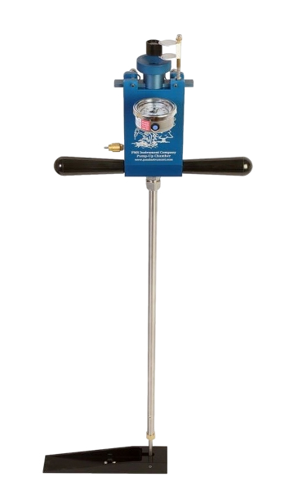
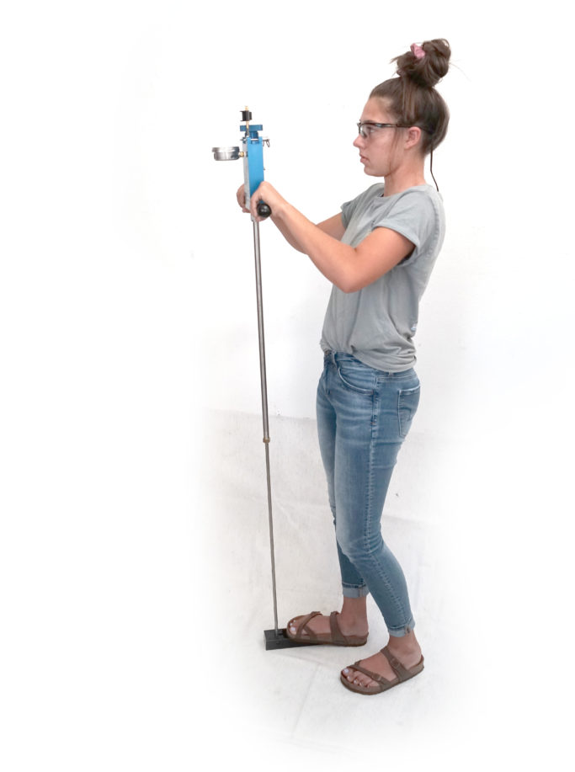

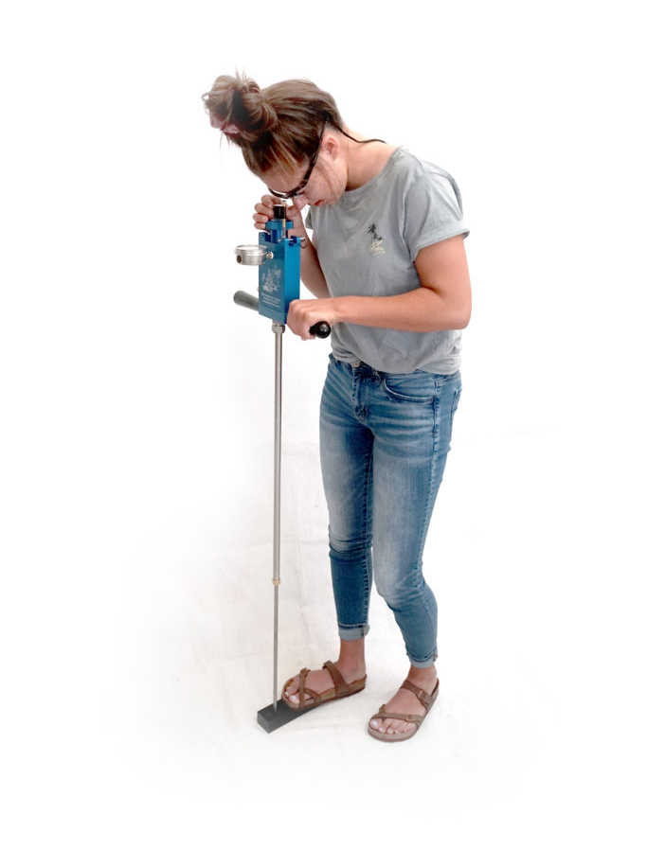
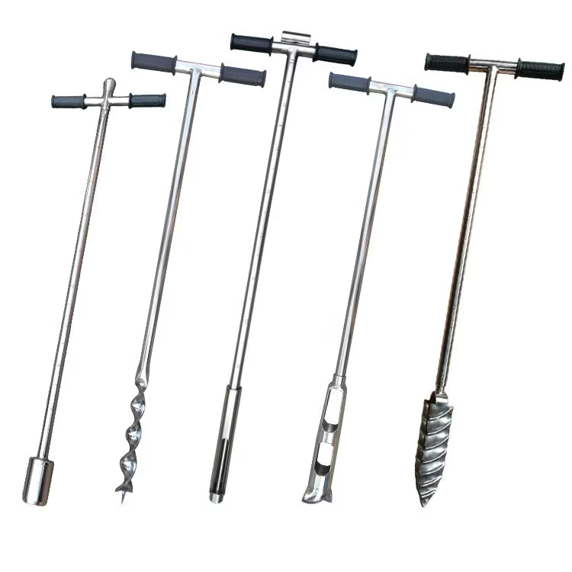
Young orchards (1–3 years old) have limited root development, making them more vulnerable to water deficits. Therefore, irrigation sceduling, and correct placement of the dripper lines is essential.
Effective Irrigation. Scheduling..
Priority in the
first year of
an orchard
#
1
Plants should be supported by stakes to prevent breakages and to promote verticality,
Using bamboo sticks of 2.5 cm diameter is a very good practice,
Use elastic tape to tie the growing shoot on stake, to maintain vertical growth, repeat ties as growth continues,
Remove shoots that are coming out of the rootstock to conserve tree resources to the vertical growth,
In hot climates, painting young tree bark in white protects it from sunburn,
Eliminate competition with weeds around the root zone
Implement a strategy to measure Midday Water Petential (Ψmd) in determining irrigation scheduling. Using a Pressure Chamber is the Gold Standard,
Learn the speed of movement of water in your soil profile,
Using tansiometers and watermark sensors are also helpful,
Have a weather station or gain access to real time climatic infoirmation in your orchard
Soil augers are useful in sampling and determining moisture issues.
Irrigation
schedule
idday Water Petential
(Ψmd)
Using an easy and reliable source for sensing plant moisture levels:
Pressure Chamber
(Pump-up Chamber)
Effective Irrigation
Scheduling
M
Easiest and most accurate
way of sensing water status
directly from the plant
Pressure Chamber
ESTABLISHING
A MODERN
Tree protectors provide protection against, animals, sunburn and herbicide damage
WALNUT
ORCHARD
JAMES D. OLSON
Nisão NutVision
Chișinău, February 27, 2025

Slide 19

Competition between weeds and your plants should be avoided using effective but most nature friendly methods,
An effective winter (pre-emerging) herbicide application can help you minimize your herbicide use during the season.
Young plants are very sensitive to herbicide demage, especially systemic ones.
Mulching, sheep grazing and cover crops are best methods in reducing herbicide use
Weed
Management
Plants should be supported by stakes to prevent breakages and to promote verticality,
Using bamboo sticks of 2.5 cm diameter is a very good practice,
Use elastic tape to tie the growing shoot on stake, to maintain vertical growth, repeat ties as growth continues,
Remove shoots that are coming out of the rootstock to conserve tree resources to the vertical growth,
In hot climates, painting young tree bark in white protects it from sunburn,
Eliminate competition with weeds around the root zone
Plant protector
ESTABLISHING
A MODERN
Tree protectors provide protection against, animals, sunburn and herbicide damage
WALNUT
ORCHARD
JAMES D. OLSON
Nisão NutVision
Chișinău, February 27, 2025

Slide 20
Definition of a “Commercial Orchard”:
DISCLAIMER:
The project „Promoting Green Deal Readiness in the Eastern Partnership Countries” (PROGRESS) is funded by the International Climate Initiative (IKI) of the German Federal Government and is implemented by the Deutsche Gesellschaft für Internationale Zusammenarbeit (GIZ) GmbH, as the lead agency, in partnership with the Organisation for Economic Co-operation and Development (OECD), the Regional Environmental Centre for the Caucasus (RECC), the European Business Association (EBA) Moldova and the Institute for Economics and Forecasting of the National Academy of Sciences of Ukraine (IEF).

Slide 21
JAMES D. OLSON
Director, Technical
Advisory Services
Thank you
Nisão NutVision
Chișinău, February 27, 2025

