Slide 1

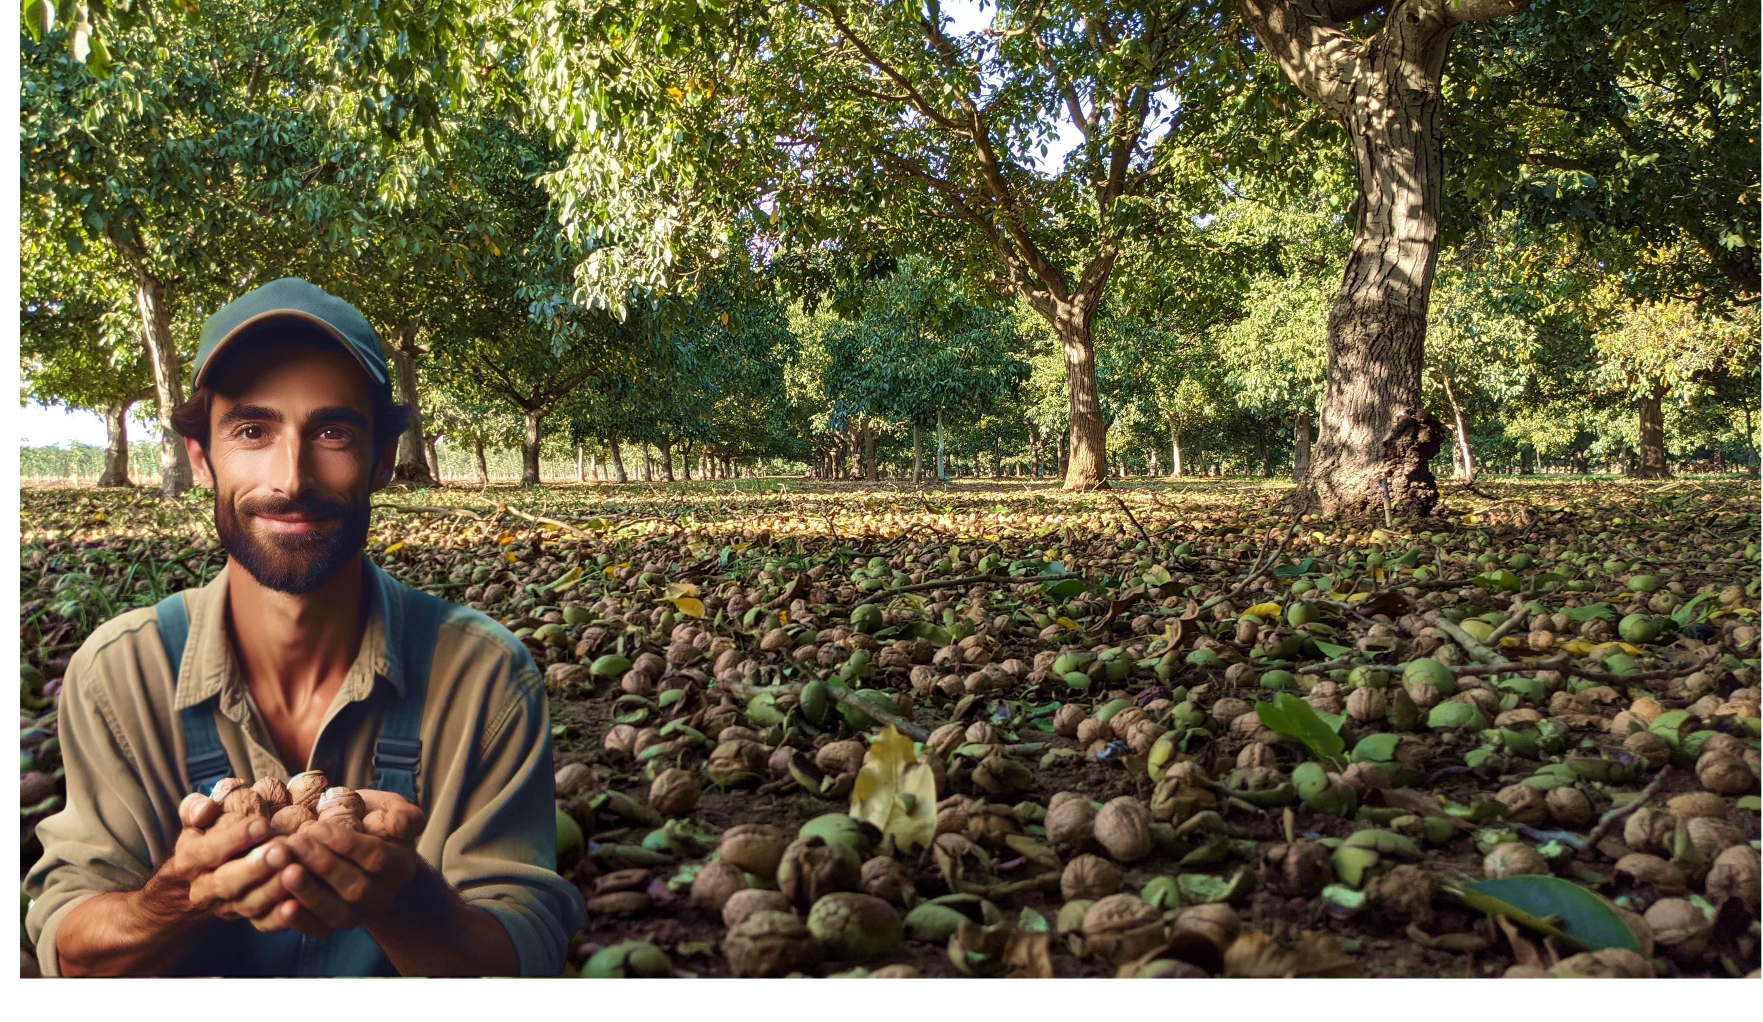


.
NUTS GROWING INDUSTRY IN THE USA: EXPERIENCE AND RELEVANT HINTS
GOVERNMENT SUPPORT FOR GROWERS
Nisão NutVision
Chișinău, February 27, 2025

Slide 2








Slide 3
Format: Focusing on common practices adapted by Commercial Walnut Orchards in California
Born in 1984, CA, USA
Residence : Tulare, CA, USA
Bachelors of Science in Agricultural Business from California State University Fresno
30 years experience in the walnut industry, since age 9
12 years ownership of walnut nursery,
20 years experience developing, managing and providing consultancy services for orchards.
JAMES D. OLSON
Director, Technical Advisory Services
Nisão
NutVision
NUTS GROWING INDUSTRY IN THE USA: EXPERIENCE AND RELEVANT HINTS
GOVERNMENT SUPPORT FOR GROWERS
JAMES D. OLSON
Nisão NutVision
Chișinău, February 27, 2025

Slide 4
Definition of a “Commercial Orchard”:
The Californian walnut industry is a highly structured and meticulously planned system, designed to operate with maximum ficiency, competitiveness, and a strong focus on sustainable growth through specializated institutions.
NUTS GROWING INDUSTRY IN THE USA: EXPERIENCE AND RELEVANT HINTS
GOVERNMENT SUPPORT FOR GROWERS
JAMES D. OLSON
Nisão NutVision
Chișinău, February 27, 2025

Slide 5
The Californian walnut industry is a highly structured and meticulously planned system, designed to operate with maximum efficiency, competitiveness, and a strong focus on sustainable growth through specialization institutions.
Definition of a “Commercial Orchard”:
Growers
Processors
Handlers
UC Davis
Nurseries
Governing Bodies
Focus on production
Outsourced services to growers
Commercialization of products
Research & Development
Breediing Program
UC Davis Extension Specialists
Working closely with UC Davis,
produciing high quality plants.
Tissue culture laboratories
Regulating industry players,
Promoting international marketing,
Provide support for industry,
Political Lobbying
NUTS GROWING INDUSTRY IN THE USA: EXPERIENCE AND RELEVANT HINTS
GOVERNMENT SUPPORT FOR GROWERS
JAMES D. OLSON
Nisão NutVision
Chișinău, February 27, 2025

Slide 6
Definition of a “Commercial Orchard”:
Operating Structure
Walnuts in USA are more or less all grown in California.
There are about 4,500 walnut growers in California.
The growers are required to sell their nuts to registered handlers. There are about 80 handlers currently registered.
The handlers process (calibrate, pack, shell) the nuts and then sell them to the world market.
NUTS GROWING INDUSTRY IN THE USA: EXPERIENCE AND RELEVANT HINTS
GOVERNMENT SUPPORT FOR GROWERS
JAMES D. OLSON
Nisão NutVision
Chișinău, February 27, 2025

Slide 7
Definition of a “Commercial Orchard”:
Organizations & Governing Bodies
The Californian Walnut Board
Established in 1948
California Walnut Commission
Established in 1987
The Walnut Alliance of California is
Established in 2025
NUTS GROWING INDUSTRY IN THE USA: EXPERIENCE AND RELEVANT HINTS
GOVERNMENT SUPPORT FOR GROWERS
JAMES D. OLSON
Nisão NutVision
Chișinău, February 27, 2025

Slide 8
Definition of a “Commercial Orchard”:
Organizations & Governing Bodies
The California Walnut Board
Mission:
US Federal Marketing Order established 1948
Promotes walnuts in the US domestic market and funds research into walnut production and post harvest handling.
If you are growing Chandler, Tulare, VX211, RX1, Serr or many others you are benefiting from technology the CWB developed.
Also developed standardized grades and requires all walnuts sold are labeled with standardized grades. You buy Light halves and pieces from CA you can be confident it will meet specific quality standards for color, half count, defects and sanitation.
NUTS GROWING INDUSTRY IN THE USA: EXPERIENCE AND RELEVANT HINTS
GOVERNMENT SUPPORT FOR GROWERS
JAMES D. OLSON
Nisão NutVision
Chișinău, February 27, 2025

Slide 9
Definition of a “Commercial Orchard”:
Organizations & Governing Bodies
California Walnut Commission
Mission:
Started in 1987 since changes in US provided money to develop export markets but CWB could not do this directly due to legal issues with how the CWB was structured.
The CWC funds health research and export market development.
Seeks to increase demand for California walnuts, but effectively walnuts in general world wide.
Gives help to exporters with trade issues; tariffs, load rejections, ect.
Some pushback from CA growers last few years as they see themselves funding programs that are benefiting their competitors in other countries.
NUTS GROWING INDUSTRY IN THE USA: EXPERIENCE AND RELEVANT HINTS
GOVERNMENT SUPPORT FOR GROWERS
JAMES D. OLSON
Nisão NutVision
Chișinău, February 27, 2025

Slide 10
Definition of a “Commercial Orchard”:
Organizations & Governing Bodies
The Walnut Alliance of California
Mission:
New organization coming out of a group called the Walnut Bargaining Association.
Voluntary organization open to anyone in the US walnut industry; growers, handlers, support companies.
Looking to organize politically in support of walnut industry in the US.
Walnut growers in the US have not generally been profitable since 2014 and have been far below cost of production since 2022. Many are getting out and moving to other crops. This group is formed by those who want to stay in walnuts to try and get the returns high enough they can do so.
NUTS GROWING INDUSTRY IN THE USA: EXPERIENCE AND RELEVANT HINTS
GOVERNMENT SUPPORT FOR GROWERS
JAMES D. OLSON
Nisão NutVision
Chișinău, February 27, 2025

Slide 11
Definition of a “Commercial Orchard”:
Other industry Structure and Support
Equipment Manufacturers,
PCAs (Pest Control Advisors),
CCAs (Certified Crop Advisors),
Technical Support and Maintenance Specialists
NUTS GROWING INDUSTRY IN THE USA: EXPERIENCE AND RELEVANT HINTS
GOVERNMENT SUPPORT FOR GROWERS
JAMES D. OLSON
Nisão NutVision
Chișinău, February 27, 2025

Slide 12
Definition of a “Commercial Orchard”:
DISCLAIMER:
The project „Promoting Green Deal Readiness in the Eastern Partnership Countries” (PROGRESS) is funded by the International Climate Initiative (IKI) of the German Federal Government and is implemented by the Deutsche Gesellschaft für Internationale Zusammenarbeit (GIZ) GmbH, as the lead agency, in partnership with the Organisation for Economic Co-operation and Development (OECD), the Regional Environmental Centre for the Caucasus (RECC), the European Business Association (EBA) Moldova and the Institute for Economics and Forecasting of the National Academy of Sciences of Ukraine (IEF).

Slide 13
JAMES D. OLSON
Director, Technical
Advisory Services
Thank you
Nisão NutVision
Chișinău, February 27, 2025

