Slide 1

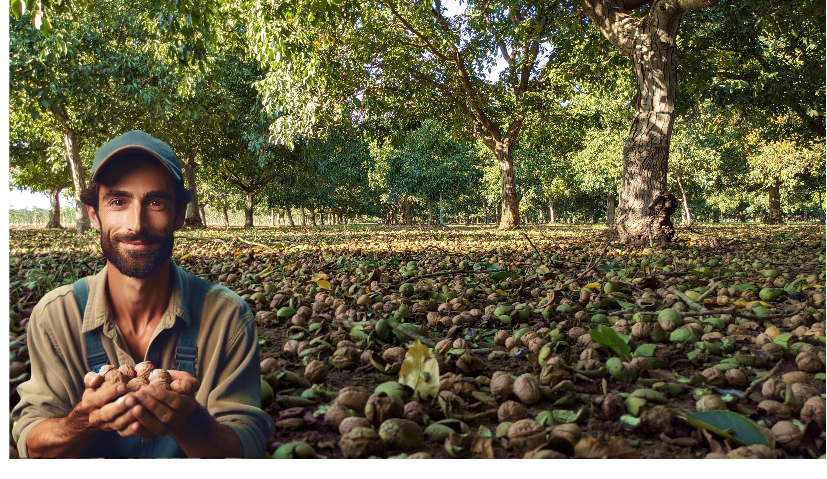


KEY ASPECTS IN TAKING CARE OF THE FRUIT-BEARING ORCHARDS IN A SYSTEMIC APPROACH.
MAIN RECOMMENDATIONS AFTER HAVING VISITED MOLDOVAN WALNUT ORCHARDS.
Nisão NutVision
Smart and green technologies for climate adaptation
Chișinău, February 27, 2025

Slide 2





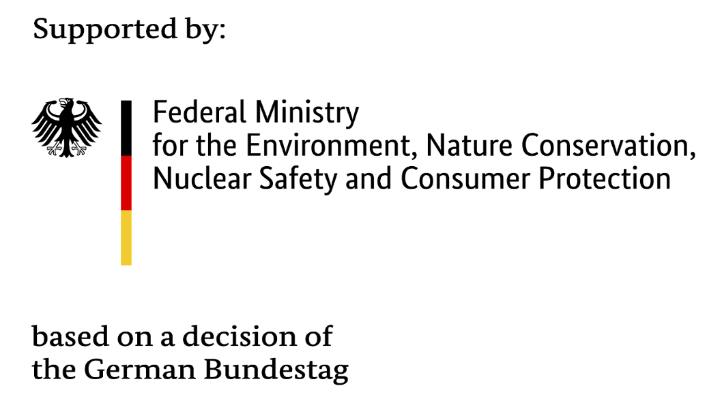


Slide 3
Format: Focusing on common practices adapted by Commercial Walnut Orchards in California
Born in 1984, CA, USA
Residence : Tulare, CA, USA
Bachelors of Science in Agricultural Business from California State University Fresno
30 years experience in the walnut industry, since age 9
12 years ownership of walnut nursery,
20 years experience developing, managing and providing consultancy services for orchards.
JAMES D. OLSON
Director, Technical Advisory Services
Nisão
NutVision
KEY ASPECTS IN TAKING CARE OF THE FRUIT-BEARING ORCHARDS IN A SYSTEMIC APPROACH.
JAMES D. OLSON
Nisão NutVision
Chișinău, February 27, 2025

Slide 4
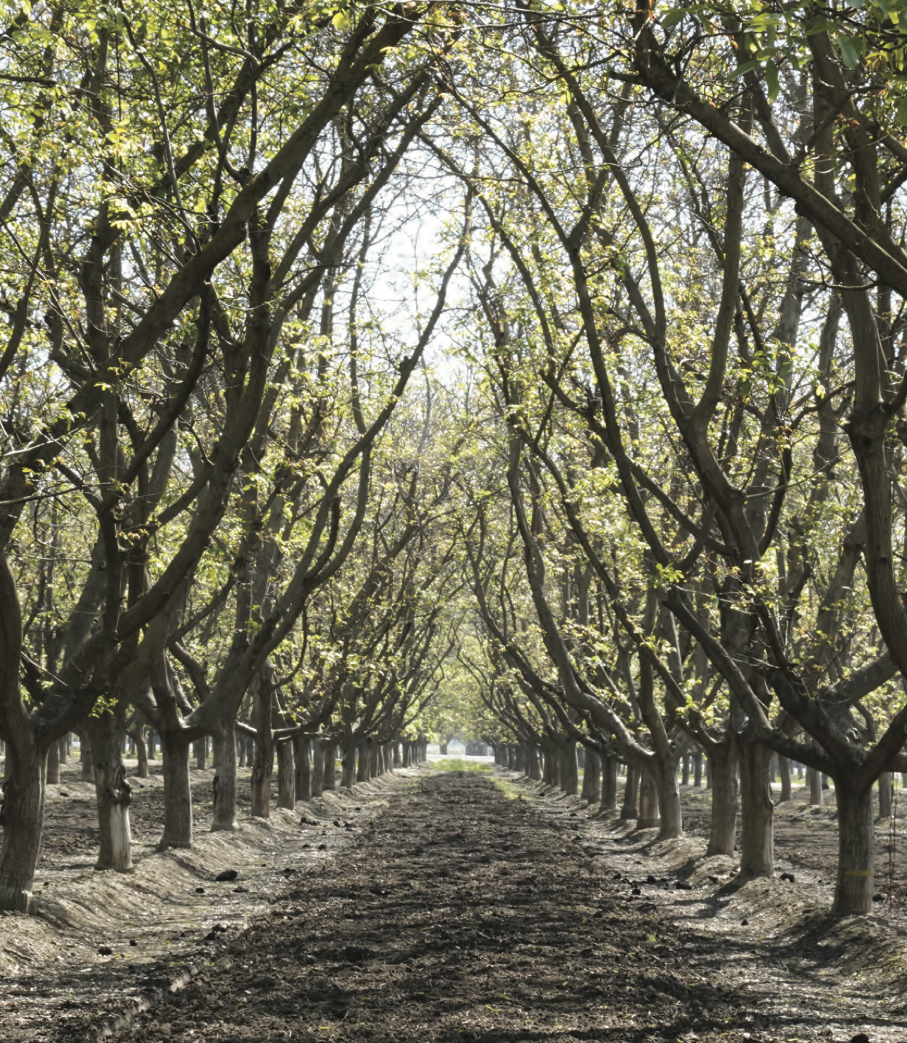
Key Recommendations
Nutrition
Definition of a “Commercial Orchard”:
Main focus should be on soil health.
Soil Quality & Nutrients
Deep, well-aerated soil with high carbon content meets most nutritional needs.
Foundation: Regular additions of compost/manure, diverse cover crops, and minimal tillage.
Micronutrient Management
Use tissue tests to check for micronutrient deficiencies.
Deficiencies vary based on soil composition.
If a nutrient is absent in the base soil, it must be supplemented.
Nutrient Availability Challenges
Some soils bind nutrients strongly, making them unavailable to trees.
Example: Zinc deficiency in California soils due to strong zinc binding.
Potassium availability seems to be a limiting factor in Moldova
KEY ASPECTS IN TAKING CARE OF THE FRUIT-BEARING ORCHARDS IN A SYSTEMIC APPROACH.
JAMES D. OLSON
Nisão NutVision
Chișinău, February 27, 2025

Slide 5
Definition of a “Commercial Orchard”:
Key Recommendations
Nutrition
Main focus should be on soil health.
Nitrogen Needs
In a well-managed system, nitrate needs are low.
Healthy trees can produce large crops without synthetic nitrogen year after year.
Test for nitrogen, but little supplementation is needed in most cases.
Potassium Management
Potassium requirements are fairly high.
Composted walnut hulls from dryers are an excellent potassium source.
Mix walnut hulls with manure when composting for greater effectiveness.
Solid debsis from walnut processing can be used as a Potassium source after being composted for a year
KEY ASPECTS IN TAKING CARE OF THE FRUIT-BEARING ORCHARDS IN A SYSTEMIC APPROACH.
JAMES D. OLSON
Nisão NutVision
Chișinău, February 27, 2025

Slide 6
Key Recommendations
Pest and Disease Control
Definition of a “Commercial Orchard”:
Pests of the Nuts:
Moths, Mites, Aphids, Empoasca (leaf hoppers), Codling Moth, Husk Fly
(Beneficial organisms, Insect growth regulators, Insecticides, baits)
Molds: Various
(Fungicides)
Blight: Bacterial infection that infects nuts early in season causing drop and black nuts. Warm wet springs increase problem.
(Copper application)
Key: Need to keep nut pests at low level to have a marketable crop. Use IPM, monitoring and degree day fixes to control with minimal chemical use. Often 1 or 2 sprays per year for all pests is adequate for perfect grades.
KEY ASPECTS IN TAKING CARE OF THE FRUIT-BEARING ORCHARDS IN A SYSTEMIC APPROACH.
JAMES D. OLSON
Nisão NutVision
Chișinău, February 27, 2025

Slide 7
Definition of a “Commercial Orchard”:
Key Recommendations
Pest and Disease Control
Pests of the tree:
Mites: Suck sap of tree, hot and dry conditions favor
Borers: Drill into tree, can spread disease
Scale: Suck sap and can spread disease
Root Rots: Phytophthora, Armillaria, Crown gall, Bark cankers.
Fungi: Botryosphaeria and Phomosis
Bacteria: Walnut Blight can hurt tree as well as nuts.
Key: Keep trees healthy or your orchard will quickly become unviable economically. Most diseases are fairly easy to prevent but difficult or impossible to control once well established.
KEY ASPECTS IN TAKING CARE OF THE FRUIT-BEARING ORCHARDS IN A SYSTEMIC APPROACH.
JAMES D. OLSON
Nisão NutVision
Chișinău, February 27, 2025

Slide 8
Definition of a “Commercial Orchard”:
Key Recommendations
Ground management with cover crops and orchard sanitation
Cover Crops
Types
Permanent
Keeping a
perennial plant
covering on
orchard floor.
Ex: Bermuda,
Alfalfa,
Legumes
Fix Nitrogen,
Easy to manage
Ex: Vetch, beans,
peas,
Brassicas
Suppresses
nematodes
Early flowering
Ex: Mustard,
Canola
Grasses
Grains to give large
biomass. Ex:
Cereal Rye,
Triticalle, Oats,
Wheat, Barley,
Forbs
Break up plow
pans and diversify
species.
EXP: Radish,
sunflowers, Flax,
Safflower
KEY ASPECTS IN TAKING CARE OF THE FRUIT-BEARING ORCHARDS IN A SYSTEMIC APPROACH.
JAMES D. OLSON
Nisão NutVision
Chișinău, February 27, 2025

Slide 9
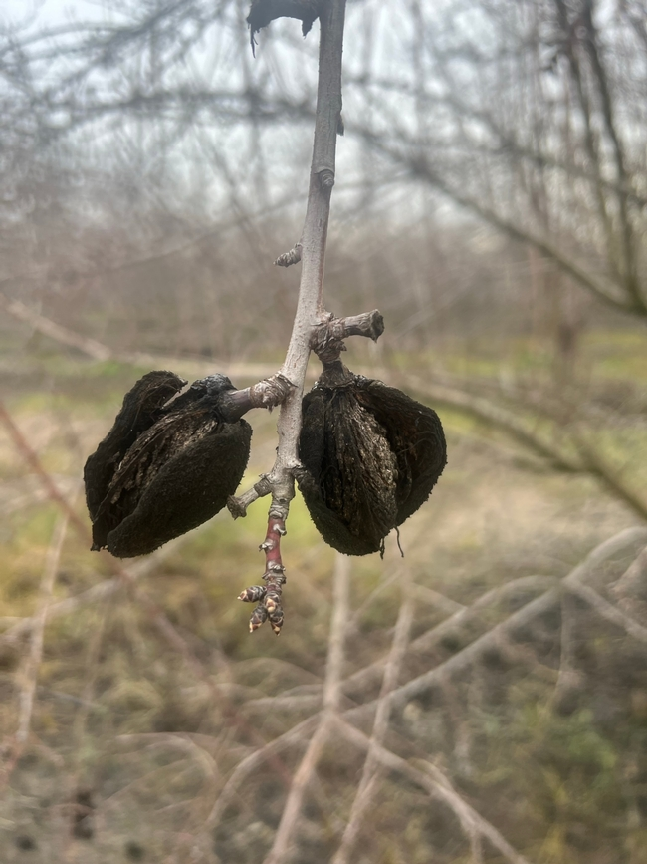
Definition of a “Commercial Orchard”:
Key Recommendations
Orchard sanitation
“Mummy” nuts:
(Nuts left in tree over winter)
Removing these nuts from the tree and placing where inhospitable to over wintering insects can greatly reduce pest pressures in your orchard.
KEY ASPECTS IN TAKING CARE OF THE FRUIT-BEARING ORCHARDS IN A SYSTEMIC APPROACH.
Mummy Nuts
JAMES D. OLSON
Nisão NutVision
Chișinău, February 27, 2025

Slide 10
Definition of a “Commercial Orchard”:
Key Recommendations
Methods of orchard sanitation:
Shake Trees
Must remove bulk
of nuts from the
trees by shaking or poling.
Ideally less than 3
nuts/tree by end of
Dec.
Gather between rows
Shaken nuts should be gather between tree rows. Preferably inside cover crop.
Grazing
Can be very
effective. Insects
will not survive
being eaten.
Grazing has other
benefits if
available.
Mowing
Most common follow up. Done early will not cause issues with cover crop.
KEY ASPECTS IN TAKING CARE OF THE FRUIT-BEARING ORCHARDS IN A SYSTEMIC APPROACH.
JAMES D. OLSON
Nisão NutVision
Chișinău, February 27, 2025

Slide 11
Definition of a “Commercial Orchard”:
Key Recommendations
Cover crops and winter fertilization
Winter/Fall fertilization has many benefits but also some risks:
Risks:
Plants are not actively using nutrients so nutrients
Can be susceptible to leaching and fixation.
Advantages:
Time and availability, typically after harvest is not a busy for other field work.
Can use less refined inputs which are often less expensive
Have lower risks.
Better nutrient cycling in orchard.
KEY ASPECTS IN TAKING CARE OF THE FRUIT-BEARING ORCHARDS IN A SYSTEMIC APPROACH.
JAMES D. OLSON
Nisão NutVision
Chișinău, February 27, 2025

Slide 12
Definition of a “Commercial Orchard”:
Key Recommendations
Cover crops – How do they help
Cover Crops:
Improve organic material,
Gather nutrients from atmosphere, which will then be integrated into soil,
Cover crops generally eliminate issues with erosion and leaching in winter.
KEY ASPECTS IN TAKING CARE OF THE FRUIT-BEARING ORCHARDS IN A SYSTEMIC APPROACH.
JAMES D. OLSON
Nisão NutVision
Chișinău, February 27, 2025

Slide 13
Definition of a “Commercial Orchard”:
Key Recommendations
Winter Soil Nutrient Applications
Soil Applications Recommended for Winter
Focus on Slow acting materials,
Composts, vary widely can be very helpful,
Manures: Some food safety concerns but in winter time period is adequate,
Grazing: Sheep and goats have been used effectively for orchard floor management.
Sulfur, Gypsum, Rock Phosphates.
KEY ASPECTS IN TAKING CARE OF THE FRUIT-BEARING ORCHARDS IN A SYSTEMIC APPROACH.
JAMES D. OLSON
Nisão NutVision
Chișinău, February 27, 2025

Slide 14
Definition of a “Commercial Orchard”:
Key Recommendations
Winter Soil Nutrient Applications to AVOID
Soil Applications You Should Not Apply in Winter
Do not apply anything concentrated or fast acting,
Especially concentrated nitrate forms like NH3 or Urea nitrogens are very susceptible to leaching,
Concentrated phosphates susceptible to runoff.
KEY ASPECTS IN TAKING CARE OF THE FRUIT-BEARING ORCHARDS IN A SYSTEMIC APPROACH.
JAMES D. OLSON
Nisão NutVision
Chișinău, February 27, 2025

Slide 15
Definition of a “Commercial Orchard”:
Key Recommendations
Early Spring Soil Nutrient Applications
Soil Applications You Should Apply before bud break
Nitrogen sources, especially for young trees,
Anything nutient in deficiency required for early tree groth,
KEY ASPECTS IN TAKING CARE OF THE FRUIT-BEARING ORCHARDS IN A SYSTEMIC APPROACH.
JAMES D. OLSON
Nisão NutVision
Chișinău, February 27, 2025

Slide 16
Definition of a “Commercial Orchard”:
Key Recommendations
Berms (borders)
How to control weeds around trees:
Spraying with pre-emergent herbicides is effective.
(Oxyfluorfen, Pendimethatin, Indaziflam)
Adding some contact herbicide gives better results, eliminating already growing weeds,
(Glyphosate, Glufosinate)
In most cases need to time application to just before rain event for them to be effective,
Two sprays per year (Fall and Spring), if well done is all needed in most cases. Burning with fire can work well also,
Walnut leaves have weed suppressing effect
KEY ASPECTS IN TAKING CARE OF THE FRUIT-BEARING ORCHARDS IN A SYSTEMIC APPROACH.
JAMES D. OLSON
Nisão NutVision
Chișinău, February 27, 2025

Slide 17
Definition of a “Commercial Orchard”:
Key Recommendations
Cover Crops
Managing Cover Crops - Permanent Covers:
Need orchard floor smooth and flat to allow efficient harvest.
Can cut and bale shortly before nut harvest
Repeated close mowings over course of season can work also
KEY ASPECTS IN TAKING CARE OF THE FRUIT-BEARING ORCHARDS IN A SYSTEMIC APPROACH.
JAMES D. OLSON
Nisão NutVision
Chișinău, February 27, 2025

Slide 18
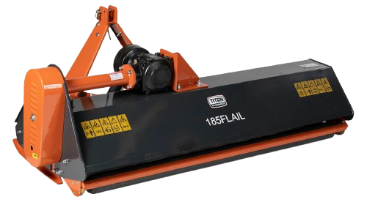
Definition of a “Commercial Orchard”:
Key Recommendations
Cover Crops
Managing Cover Crops – Annual Covers:
1. Around the time that walnuts leaf out in the spring mow tops of cover crop about ½ meter above orchard floor so stunt growth and keep from competing with trees.
2. As get into summer mow close to the ground with flail mower to terminate. By July should have orchard floor smooth and flat with cover crop debris well broken down.
Flail Mower
KEY ASPECTS IN TAKING CARE OF THE FRUIT-BEARING ORCHARDS IN A SYSTEMIC APPROACH.
JAMES D. OLSON
Nisão NutVision
Chișinău, February 27, 2025

Slide 19
Definition of a “Commercial Orchard”:
Key Recommendations
Inherent conflict between soil health with harvest requirements
Ideal Conditions for Soil Health
Ideal Conditions for Ease of Harvest
Think of a healthy forest:
Have ground hard and flat without a living thing in sight except for the trees.
Problems:
Pests,
Erosion,
Dust,
Heat,
Disease,
Pollution,
You rarely see diseased or insect ridden plants
Nutrient deficiencies are not apparent Huge diversity of life
Problem with this system is we are not able to harvest the crop and most of the crop is consumed by various life forms in the system.
Low productivity,
Soil structure degraded,
Water penetration issues,
Excessive fertilizer requirements.
KEY ASPECTS IN TAKING CARE OF THE FRUIT-BEARING ORCHARDS IN A SYSTEMIC APPROACH.
JAMES D. OLSON
Nisão NutVision
Chișinău, February 27, 2025

Slide 20
Definition of a “Commercial Orchard”:
Key Recommendations
Inherent conflict between soil health with harvest requirements
How to reconcile the conflict between ideal of soil health and ease of harvest?
Recognize that there are going to be compromises to any Decisions in this area
but prioritize soil health in most cases.
Key points:
Some weeds at harvest are much more problematic than others:
On borders and ends are difficult, in middles not so much
Short grasses not a problem in most cases
Weather conditions, moisture makes more difficult if heavy debris,
Better soil health helps with water holding, quicker re-entry after rain
Equipment makes a difference also.
Vine like plants can wrap into harvest equipment; brome grass
KEY ASPECTS IN TAKING CARE OF THE FRUIT-BEARING ORCHARDS IN A SYSTEMIC APPROACH.
JAMES D. OLSON
Nisão NutVision
Chișinău, February 27, 2025

Slide 21
Definition of a “Commercial Orchard”:
Key Recommendations
Inherent conflict between soil health with harvest requirements
Systems that work,
Example 1:
Starts with smooth middles and keep smooth; no tracks or ruts.
Minimal border growth.
Have borders mostly free of growing weeds by use of pre-emergent herbicides.
Spot spray.
Have middles mowed so no growing weeds over 12 cm tall by harvest.
Overall debris in middles no more than 8 cm deep.
Know your soil, as it gets healthier it will break down debris more quickly and you can wait till closer to harvest to mow middles.
KEY ASPECTS IN TAKING CARE OF THE FRUIT-BEARING ORCHARDS IN A SYSTEMIC APPROACH.
JAMES D. OLSON
Nisão NutVision
Chișinău, February 27, 2025

Slide 22
Definition of a “Commercial Orchard”:
Key Recommendations
Inherent conflict between soil health with harvest requirements
Systems that work,
Example 2:
Started with rough middles growing mixture of plants from area in spring.
Heavy winter growth on borders
Will need to till middles to get smooth enough to harvest. This must be done early enough that rain will pack ground surface before harvest.
Plant growth on border cut down, or killed with contact herbicides.
Will need to till ground to allow efficient harvest.
KEY ASPECTS IN TAKING CARE OF THE FRUIT-BEARING ORCHARDS IN A SYSTEMIC APPROACH.
JAMES D. OLSON
Nisão NutVision
Chișinău, February 27, 2025

Slide 23
Definition of a “Commercial Orchard”:
Key Recommendations
Inherent conflict between soil health with harvest requirements
Systems that work,
Example 3:
Non-herbicide system
Use flame weeding to keep borders free of weeds,
Some hand weeding for misses. Need to flame when 5-8cm tall
As long as middles are flat to start use mowing to manage growth. Leave growth high as long as possible based on breakdown capacity of soil.
Shortly before harvest do hand prep of borders followed by low mowing.
KEY ASPECTS IN TAKING CARE OF THE FRUIT-BEARING ORCHARDS IN A SYSTEMIC APPROACH.
JAMES D. OLSON
Nisão NutVision
Chișinău, February 27, 2025

Slide 24
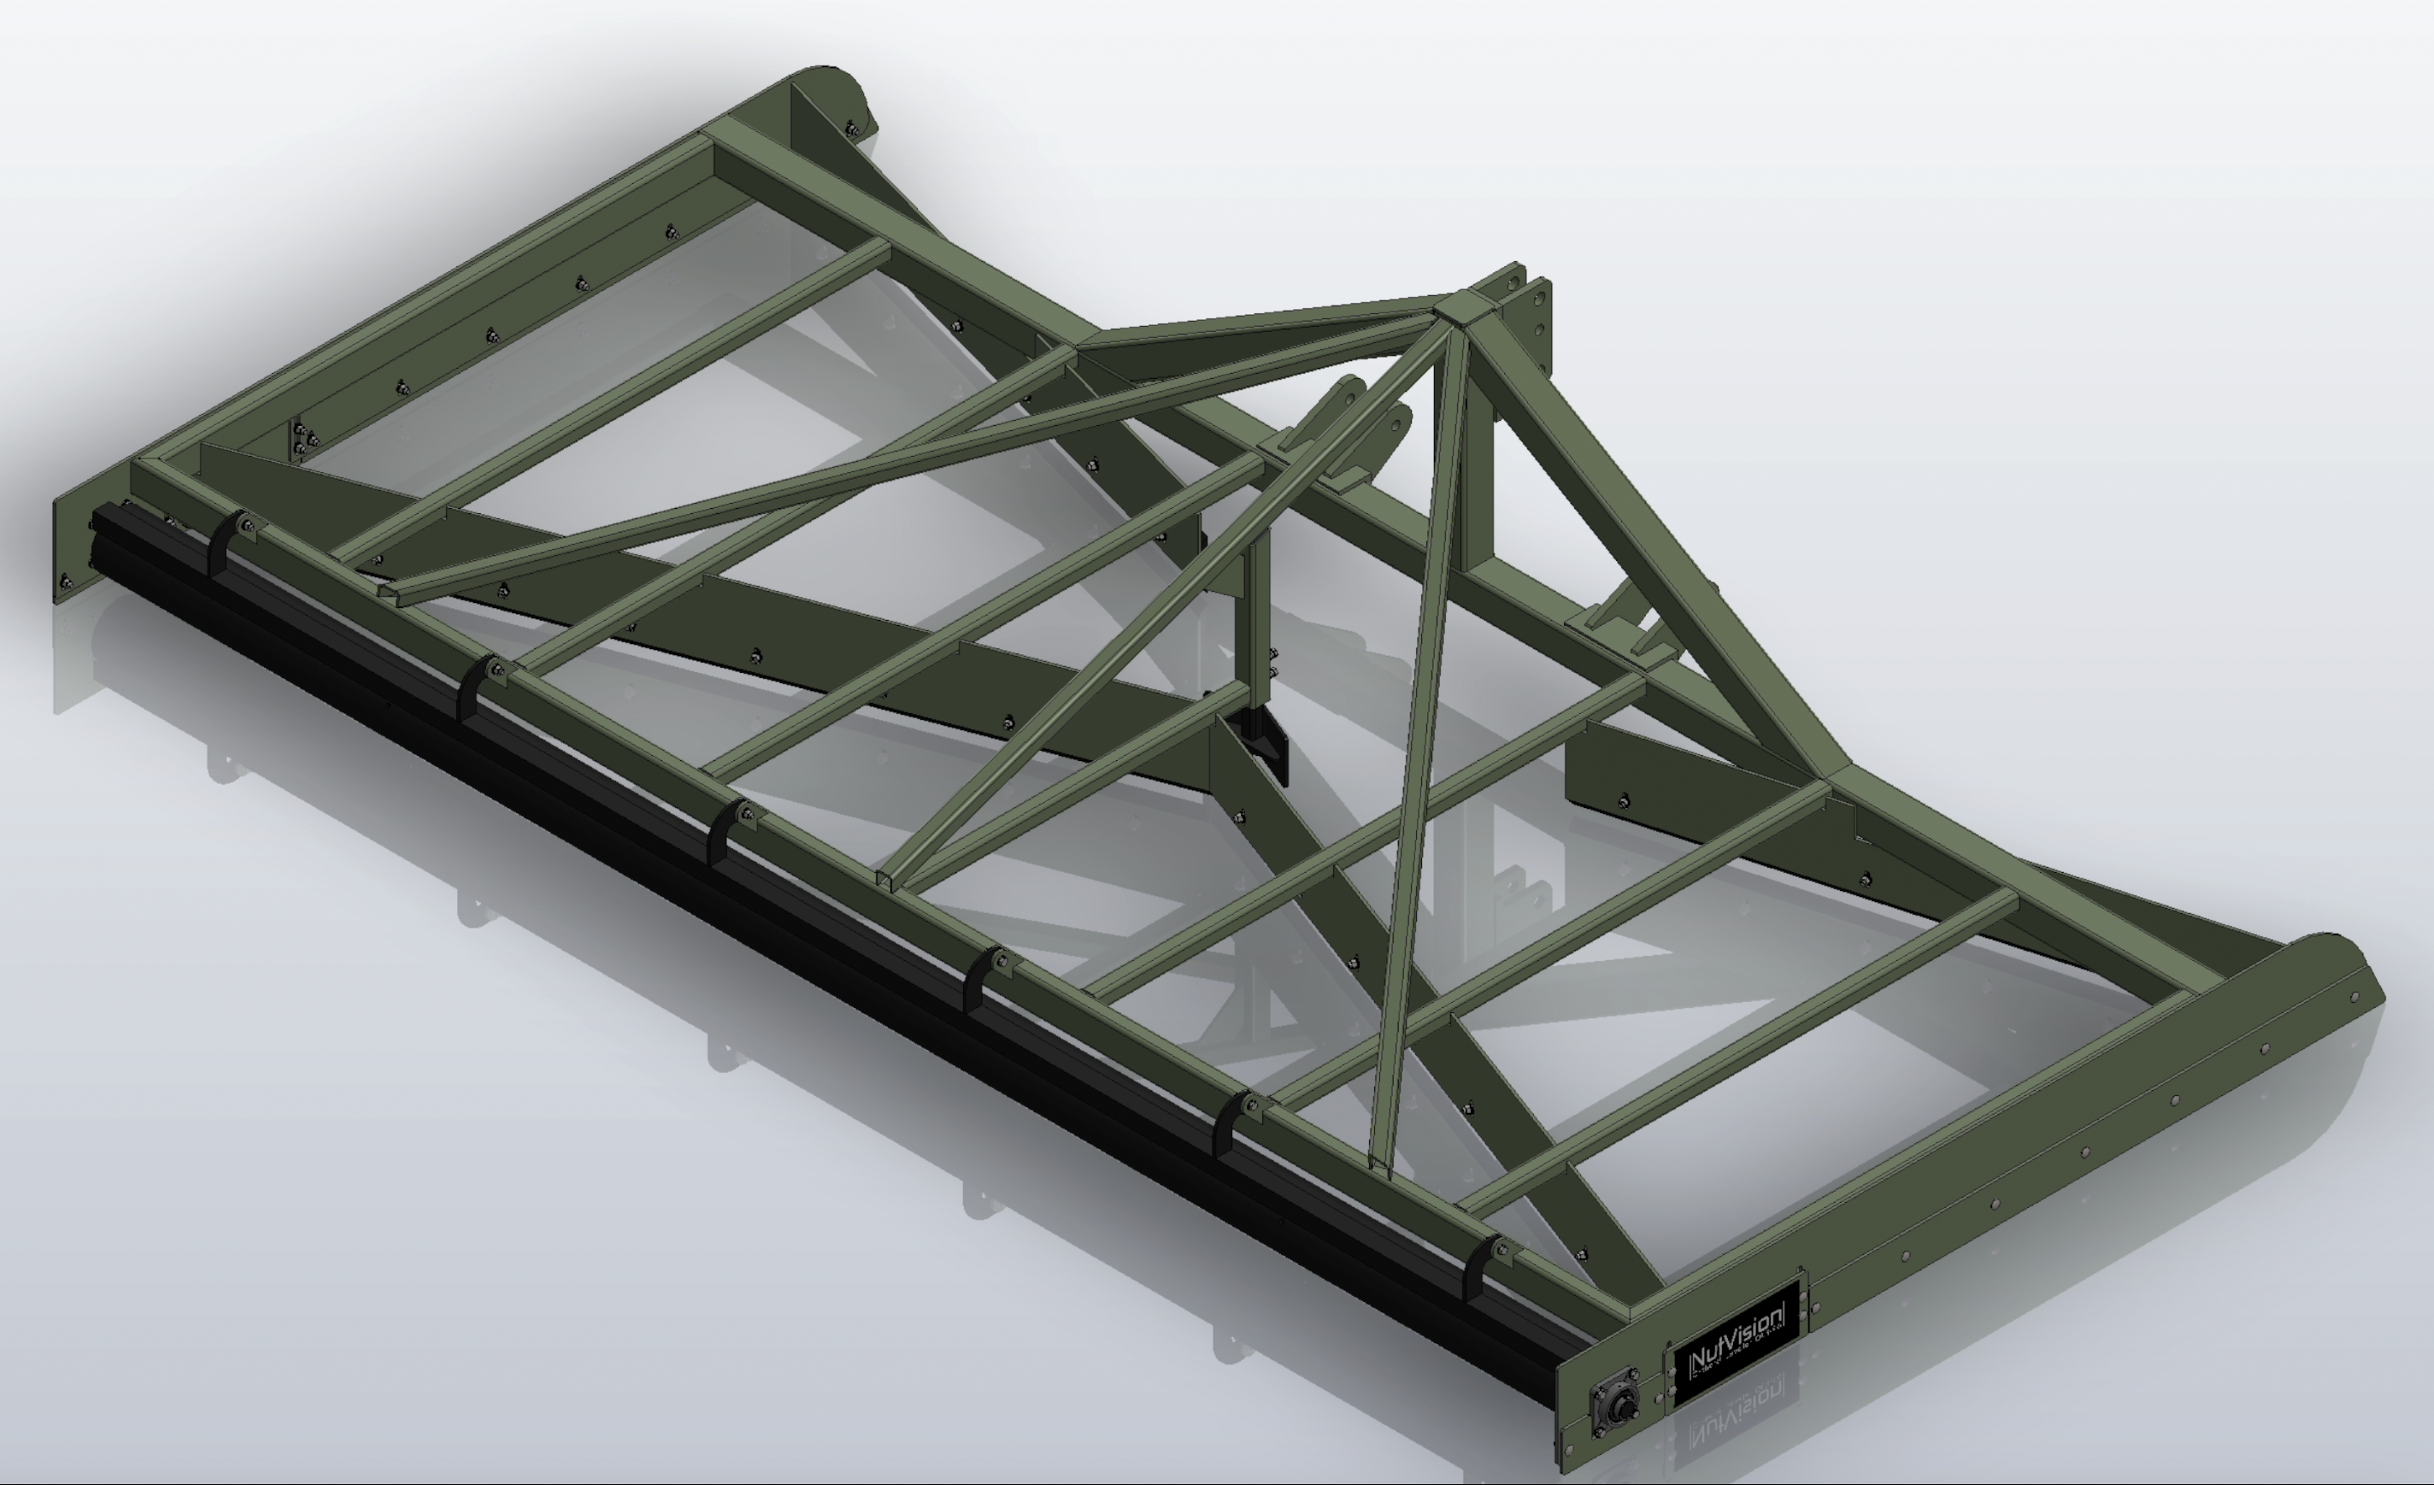
Definition of a “Commercial Orchard”:
Key Recommendations
Improve Orchard Surface for mechanical harvesting
Orchard Surface Preparation, Maintenance
Preparing your orchard surface for mechanical harvesting is one of the most valuable investments you can make. It speeds up harvest and minimize labor
Building a flat, and firm top layer takes time, Using a heavy orchard leveler with a built in roller, is highly effective,
You should maintain the orchard surface by:
Avoiding using heavy equipment on wet soil,
Avoid unnecessary tilling
Orchard Leveler
KEY ASPECTS IN TAKING CARE OF THE FRUIT-BEARING ORCHARDS IN A SYSTEMIC APPROACH.
JAMES D. OLSON
Nisão NutVision
Chișinău, February 27, 2025

Slide 25
Definition of a “Commercial Orchard”:
Key Recommendations
Pruning
Most pruning is of young trees
Mature trees don’t need to be pruned every year.
It is important to prune out dead and diseased branches as they can spread disease into neighboring trees and increase disease pressure.
Also need to periodically prune to regenerate the tree by getting new wood on the tree.
Pruning to keep trees harvestable and keep total height low enough can be reached by sprayers is important.
Keeping light interception in a healthy range can also be productive.
KEY ASPECTS IN TAKING CARE OF THE FRUIT-BEARING ORCHARDS IN A SYSTEMIC APPROACH.
JAMES D. OLSON
Nisão NutVision
Chișinău, February 27, 2025

Slide 26
Definition of a “Commercial Orchard”:
Key Recommendations
Pruning - Mature Orchards
Why pruning is necessary:
Disease control,
Maintaining Orchard Access,
Maintaining Production,
Orchard renewal
KEY ASPECTS IN TAKING CARE OF THE FRUIT-BEARING ORCHARDS IN A SYSTEMIC APPROACH.
JAMES D. OLSON
Nisão NutVision
Chișinău, February 27, 2025

Slide 27
Definition of a “Commercial Orchard”:
Key Recommendations
Pruning - Mature Orchards
Pruning for disease control:
Some diseases in orchards can breed in deadwood. Botryosphaeria and Phomopsis in particular.
Some canker diseases can be controlled by pruning
Branch wilt; prune out to reduce spreading
Flat headed borer; prune out and burn infested wood to reduce population
Key Point:
Removing dead wood from trees is an important part of long term orchard health.
KEY ASPECTS IN TAKING CARE OF THE FRUIT-BEARING ORCHARDS IN A SYSTEMIC APPROACH.
JAMES D. OLSON
Nisão NutVision
Chișinău, February 27, 2025

Slide 28
Definition of a “Commercial Orchard”:
Key Recommendations
Pruning - Mature Orchards
Pruning for maintaining orchard access:
Two main areas to watch:
Branching that will block physical access of equipment such as branching into aisles and into shaker grab areas. Also need to watch For spray penetration, if have tree grown where your sprayers are not Able to reach all of tree area that will greatly reduce your ability to Control pests with chemicals. This is an issue if trees get too tall, or too dense.
Harvest brush; In older trees that are not pruned for many years The harvest process tends to give a harvest of sticks mixed with the Nuts. This is difficult to deal with, and breaks equipment. Keeping Trees pruned allows brush to be dealt with on your timing. Not In mid harvest when the brush is blocking the crop from getting to market.
KEY ASPECTS IN TAKING CARE OF THE FRUIT-BEARING ORCHARDS IN A SYSTEMIC APPROACH.
JAMES D. OLSON
Nisão NutVision
Chișinău, February 27, 2025

Slide 29
Definition of a “Commercial Orchard”:
Key Recommendations
Pruning - Mature Orchards
Pruning for maintaining production:
In many cases orchards will see a decline in production and quality sometime between years 8 and 15.
Pruning will reduce overlapping branches that prevents light interception
Regular pruning can help prevent this by spurring the tree to grow newer wood on a regular basis.
Typical method, if there are not any specific disease issues, is to prune producing orchards every 3-5 years.
Idea is to cut out any dead, diseased or injured branches and periodically make a heading cut so tree will grow new fruiting wood in that area.
KEY ASPECTS IN TAKING CARE OF THE FRUIT-BEARING ORCHARDS IN A SYSTEMIC APPROACH.
JAMES D. OLSON
Nisão NutVision
Chișinău, February 27, 2025

Slide 30
Definition of a “Commercial Orchard”:
Key Recommendations
Pruning - Mature Orchards
Pruning for orchard renewal:
There comes a point in an orchards life, typically around year 20-25 where it is not longer producing the quantity and quality of nuts it once did.
In some cases the best option is to remove the orchard and replant it. In other cases we have had good success giving such trees a heavy pruning,
You will loose one year of production while tree grows new fruitwood, and if all goes well have kept orchards in production for 40-60 years.
Key Point:
Look over orchard before deciding to do this: Variety, rootstock, root diseases, missing trees. If you have a variety and rootstock that is still competitive and are not missing many trees renewal can work. It will not improve underlying potential of orchard or replace missing trees.
KEY ASPECTS IN TAKING CARE OF THE FRUIT-BEARING ORCHARDS IN A SYSTEMIC APPROACH.
JAMES D. OLSON
Nisão NutVision
Chișinău, February 27, 2025

Slide 31
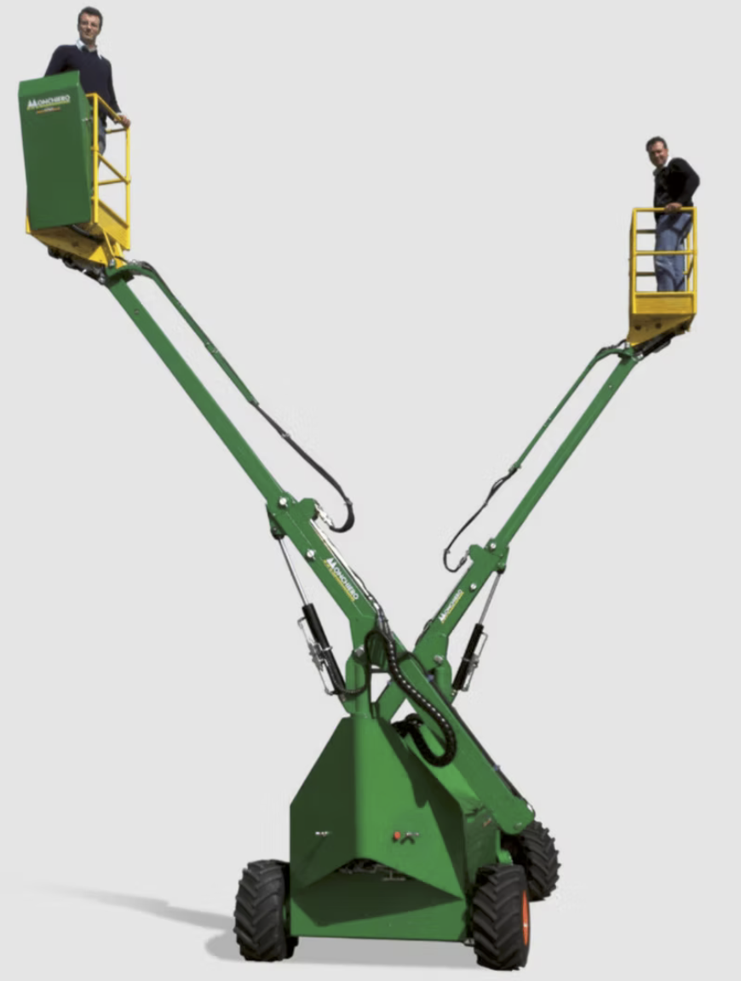
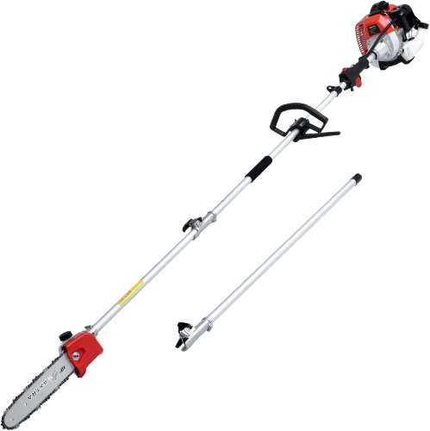
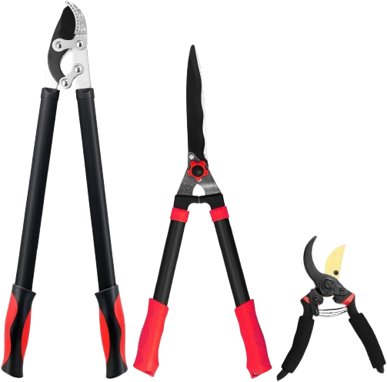
Definition of a “Commercial Orchard”:
Key Recommendations
Pruning - Mature Orchards
Pruning equipmet and methods
Young trees, years 1-3:
Clippers and Loppers
Middle aged, years 3-8:
Pole pruners and chainsaws can work. If pruning towers are available they can be more efficient.
Older orchards, Years 8+.
Need pruning towers to reach into canopy. Pole type hydraulic saws powered by machine.
Disinfect pruning tools often to prevent spread of dissease.
(Bleach, Hydrogen peroxide)
KEY ASPECTS IN TAKING CARE OF THE FRUIT-BEARING ORCHARDS IN A SYSTEMIC APPROACH.
JAMES D. OLSON
Nisão NutVision
Chișinău, February 27, 2025

Slide 32
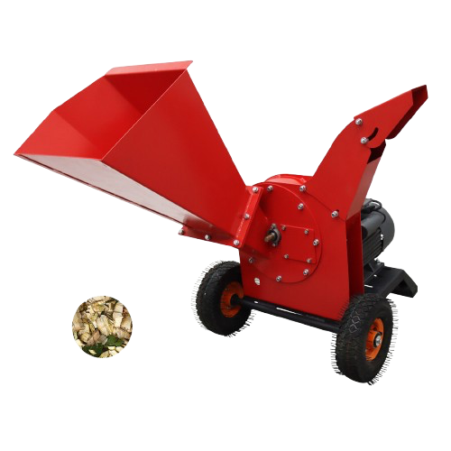
Definition of a “Commercial Orchard”:
Key Recommendations
Pruning - Mature Orchards
Wood: What to do with it ?
Best method for soil is to grind the branches and leave the wood chips on the ground to break down and add to the soil.
But equipment can be expensive and is not always available. Branches less than about 8cm grind easily with tractor mounted equipment.
Moving wood out of orchard and burning is best option for diseased branches
KEY ASPECTS IN TAKING CARE OF THE FRUIT-BEARING ORCHARDS IN A SYSTEMIC APPROACH.
JAMES D. OLSON
Nisão NutVision
Chișinău, February 27, 2025

Slide 33
Definition of a “Commercial Orchard”:
DISCLAIMER:
The project “Promoting Green Deal Readiness in the Eastern Partnership Countries” (PROGRESS) is funded by the International Climate Initiative (IKI) of the German Federal Government and is implemented by the Deutsche Gesellschaft für Internationale Zusammenarbeit (GIZ) GmbH, as the lead agency, in partnership with the Organisation for Economic Co-operation and Development (OECD), the Regional Environmental Centre for the Caucasus (RECC), the European Business Association (EBA) Moldova and the Institute for Economics and Forecasting of the National Academy of Sciences of Ukraine (IEF).

Slide 34
JAMES D. OLSON
Director, Technical
Advisory Services
Thank you
Nisão NutVision
Chișinău, February 27, 2025

