Slide 1

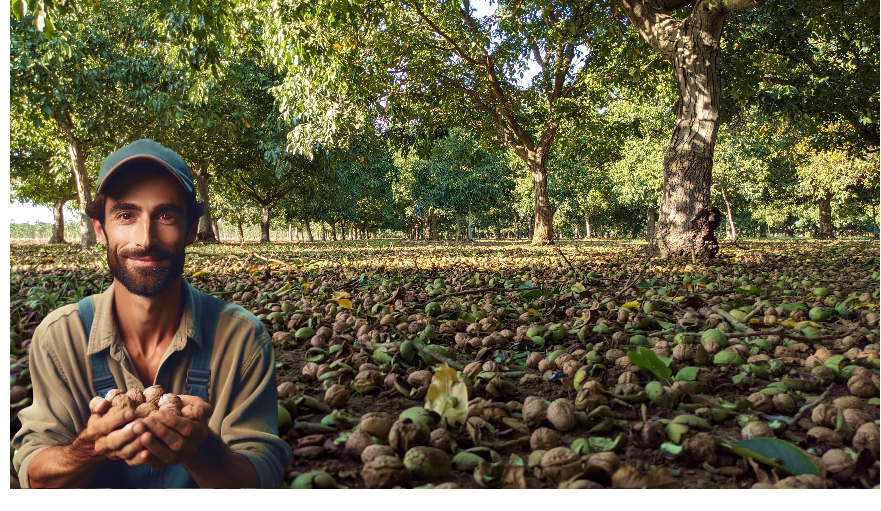


MURAT BADEM
THE GLOBAL WALNUT MARKETS. TENDENCIES AND PERSPECTIVES.
Managing Director
GLOBAL FUTURE FOR NUTS GROWERS: TENDENCIES TO CONSIDER
Nisão NutVision
Chișinău, February 27, 2025

Slide 2
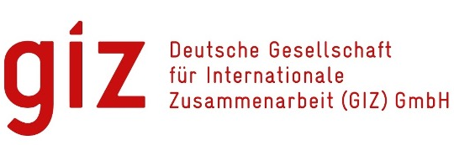







Slide 3
Born in 1971, Istanbul, TURKEY
Residence : Lisbon, PORTUGAL
Masters in Business Administration – Financial Management, Pace University, New York, NY
20 years experience in the walnut industry, as a grower, processor, with international brands
Owned and operated the largest Commercial Walnut Nursery in Europe,
Areas of expertise :
Strategic Business Plans for Agricultural Projects,
Orchard Design and Establisment,
Harvest and Processing Technologies,
Improving Quality and Operational Efficiency in Walnut Production
International Marketing and establishing brands
MURAT BADEM
Managing Director
Nisão
NutVision
THE GLOBAL WALNUT MARKETS. TENDENCIES AND PERSPECTIVE
GLOBAL FUTURE FOR NUTS GROWERS: TENDENCIES TO CONSIDER
MURAT BADEM
Nisão NutVision
Chișinău, February 27, 2025

Slide 4
Key Trends in Global Walnut Markets 2000 - 2024
THE GLOBAL WALNUT MARKETS. TENDENCIES AND PERSPECTIVE
GLOBAL FUTURE FOR NUTS GROWERS: TENDENCIES TO CONSIDER
MURAT BADEM
Nisão NutVision
Chișinău, February 27, 2025

Slide 5
Key Trends in Global Walnut Markets 2000 - 2024
Harvested are in CA and production increased significantly due to investments made by funds
Prices have dropped significantly,
Clear move to marketing Kernels, from in-shell
CA orchards began to be abondoned or removed, due to unsustainable prices and changes in water use regulations,
Chinese production has increased over its consumptions. China becoming a major exporter,
Local/Regional Production gaining importance, due to food security concerns and COVID
Ukraine, the sleeping giant in Europe
THE GLOBAL WALNUT MARKETS. TENDENCIES AND PERSPECTIVE
GLOBAL FUTURE FOR NUTS GROWERS: TENDENCIES TO CONSIDER
MURAT BADEM
Nisão NutVision
Chișinău, February 27, 2025

Slide 6
As US production increased, Average Walnut Prices Dropped Significantly
Percentage of Kernel Sales within total production is increasing steadily
US production, metric tons, in-shell basis
US FOB prices, in-shell USD/Kg basis
Average Cost of Production USD/Kg
THE GLOBAL WALNUT MARKETS. TENDENCIES AND PERSPECTIVE
GLOBAL FUTURE FOR NUTS GROWERS: TENDENCIES TO CONSIDER
MURAT BADEM
Nisão NutVision
Chișinău, February 27, 2025
US Sales Distribution Comparison 2012 - 2023

Slide 7
Kernel is in the rise
Percentage of Kernel Sales within total production is increasing steadily
 | In-Shell | Kernel
2023 | 150,572 | 269,237
2012 | 138,866 | 138,859
2023 | 19.9% | 80.1%
2012 | 30.7% | 69.3%
US Sales Distribution Comparison 2012 – 2023
Metric tons
THE GLOBAL WALNUT MARKETS. TENDENCIES AND PERSPECTIVE
GLOBAL FUTURE FOR NUTS GROWERS: TENDENCIES TO CONSIDER
MURAT BADEM
Nisão NutVision
Chișinău, February 27, 2025

Slide 8
Evolution of Global Walnut Production 2000 - 2024
THE GLOBAL WALNUT MARKETS. TENDENCIES AND PERSPECTIVE
GLOBAL FUTURE FOR NUTS GROWERS: TENDENCIES TO CONSIDER
MURAT BADEM
Nisão NutVision
Chișinău, February 27, 2025

Slide 9
PRODUCTION (1,000 Metric Tons)
THE GLOBAL WALNUT MARKETS. TENDENCIES AND PERSPECTIVE
GLOBAL FUTURE FOR NUTS GROWERS: TENDENCIES TO CONSIDER
MURAT BADEM
Nisão NutVision
Chișinău, February 27, 2025

Slide 10
Exports (1,000 Metric Tons)
THE GLOBAL WALNUT MARKETS. TENDENCIES AND PERSPECTIVE
GLOBAL FUTURE FOR NUTS GROWERS: TENDENCIES TO CONSIDER
MURAT BADEM
Nisão NutVision
Chișinău, February 27, 2025

Slide 11


Share in Global Walnut Exports
USA
THE GLOBAL WALNUT MARKETS. TENDENCIES AND PERSPECTIVE
GLOBAL FUTURE FOR NUTS GROWERS: TENDENCIES TO CONSIDER
KEY POINT:
US Share in Global Walnut Exports declining
MURAT BADEM
Nisão NutVision
Chișinău, February 27, 2025

Slide 12

Share in Global Walnut Exports
China
THE GLOBAL WALNUT MARKETS. TENDENCIES AND PERSPECTIVE
GLOBAL FUTURE FOR NUTS GROWERS: TENDENCIES TO CONSIDER
KEY POINT:
Chinese Share in Global Walnut Exports increasing steadily
MURAT BADEM
Nisão NutVision
Chișinău, February 27, 2025

Slide 13
Share in Global Walnut Exports
Chile
THE GLOBAL WALNUT MARKETS. TENDENCIES AND PERSPECTIVE
GLOBAL FUTURE FOR NUTS GROWERS: TENDENCIES TO CONSIDER
KEY POINT:
Chilean Share in Global Walnut Exports is steady
MURAT BADEM
Nisão NutVision
Chișinău, February 27, 2025

Slide 14
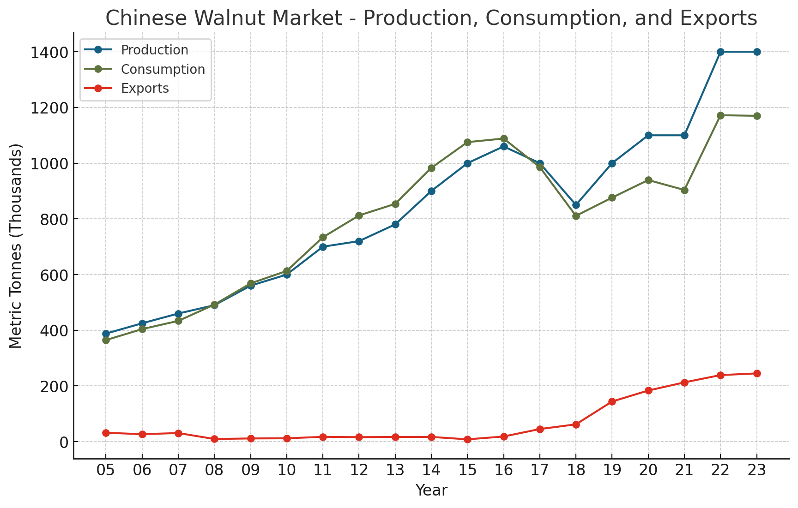
Share in Global Walnut Exports
China
THE GLOBAL WALNUT MARKETS. TENDENCIES AND PERSPECTIVE
GLOBAL FUTURE FOR NUTS GROWERS: TENDENCIES TO CONSIDER
KEY POINT:
Chinese Share in Global Walnut Exports increasing steadily
MURAT BADEM
Nisão NutVision
Chișinău, February 27, 2025

Slide 15
Definition of a “Commercial Orchard”:
DISCLAIMER:
The project „Promoting Green Deal Readiness in the Eastern Partnership Countries” (PROGRESS) is funded by the International Climate Initiative (IKI) of the German Federal Government and is implemented by the Deutsche Gesellschaft für Internationale Zusammenarbeit (GIZ) GmbH, as the lead agency, in partnership with the Organisation for Economic Co-operation and Development (OECD), the Regional Environmental Centre for the Caucasus (RECC), the European Business Association (EBA) Moldova and the Institute for Economics and Forecasting of the National Academy of Sciences of Ukraine (IEF).

Slide 16
MURAT BADEM
Managing Director
Thank you
Nisão NutVision
Chișinău, February 27, 2025

